Slide 1
California
Structured Decision Making® Model
Advanced Supervisor Training
Notes:
Welcome and introductions.
Note to trainer: One option is to have everyone introduce themselves by name, county, and unit supervised, plus the first word that comes into their head when they hear “SDM.” Record these words on a flip chart. You can revisit near the end to see if this word association changes. This will also give you a chance to understand what kind of resistance, if any, you may face. You can focus optional comments and activities to more directly address the type of resistance expressed (e.g., paperwork/time-consuming/non-professional) and reinforce positive statements (e.g., consistent/focused/research-based).
Review the agenda.
If this session is not consecutive with previous sessions, begin again with title slide, welcome, and introductions, and repeat training goals.

Slide 2
Training Goals
Supervisors will:
Increase their expertise in Structured Decision Making® (SDM) practice in order to serve as a resource for their staff
Learn ways to integrate SDM® assessments and decisions into key supervisory processes
Gain knowledge and skill to help motivate workers in their units to contribute to better outcomes through quality SDM implementation
Notes:
Let’s review the goals for this training.
Note to trainer: You may present different anecdotes depending on whether the class is made up of newly promoted supervisors or supervisors who are just getting this information for the first time. The key is to recognize that supervisors are hugely influential in the operation of their units. Acknowledge the difficult work they do. One option is to create a teachable moment by asking them to think about their unit today—what life is like, what they enjoy, what frustrates them, how it feels to go home at night. Ask them to think about how they would like their unit to look two years from now. Do they want more of the same? Do they want to grow their workers, retain their workers, and have a cohesive, highly skilled unit? This curriculum provides tools they can use to start their unit on a journey toward being a premier unit.

Slide 3

Roundtable
On a scale from 0 to 10, with 0 representing no knowledge and 10 representing expertise, how do you rate your knowledge about the tools and practices of the SDM model?
What are your supervisory practices in supporting the use of SDM assessments in making key decisions with families?
Notes:
Note to trainer: You can use this time to allow participants to reflect upon various SDM model-related issues in their unit at the start of each module. The amount of time and specific exercise can vary. It is designed to be flexible so that you can individualize sessions. If sessions are being held back-to-back, you may just do a brief check-in. If the group is reuniting after weeks, you may check in to see how things have gone since last time and whether they’ve tried any of their new skills. You can use the time to recap what has been covered. You also can include an exercise of your own choosing that would highlight a specific issue for the group you are training.

Slide 4
Supervisory Leadership in Practice Change
Notes:
Lawrence Shulman, in his book Interactional Supervision, talks about supervisors being in the position to most directly monitor the skills development of their workers. As a result, supervisors are the group within the organization that has the largest sphere of influence on practice change. The ability for the supervisor to model and use the skills they hope to see in the caseworker during supervision is an effective way to teach and reinforce.
We are going to focus in on supervisory functions and leadership related to use of both SDM assessments and practices that support shared assessment and decision making with families.

Slide 5
Supervisor Support for Practice Change
Planned integration of new knowledge or skill in daily practice
Communicating explicit support for use of new skill
Providing opportunities for practice
Allowing time for development of new skills
Role modeling
Positive reinforcement
Creating agreements for trying new skills
Arranging time to practice
Celebrating successes
Adapted from Broad, M. L., & Newstrom, J. W. (1992). Transfer of training: Action-packed strategies to ensure high payoff from training investment. New York , NY: Basic Books.
Notes:
Say: Broad and Newstrom identified these supervisory strategies for supporting transfer of learning for recently trained staff in order to adopt new practices into daily work.
Trainer Note: Review the list with participants. Ask them to reflect on which strategies have made the most difference in their own skill development.

Slide 6

Assessments With, Not About Families
Supervisors can communicate that SDM assessments are not just paperwork—they are prompts for practice!
Notes:
Say: As a supervisor, you are in the best position to communicate that assessments are conducted with families and assessment results are documented in the webSDM application.
Assessments are prompts for practice, and supervisors can model this strategy in everyday supervisory conversations.

Slide 7

Solution-Focused Supervision
Notes:
Solution-focused supervision is the notion of working in partnership−that one is not working alone, but as part of a team.
This results in skill development of all those involved in the partnership or team.
www.solutionbasedcasework.com
Discuss this as working with workers the way we hope workers will work with families.

Slide 8

What is solution-focused inquiry?
The practice of using questions and conversations to strengthen an individual’s capacity to achieve their own best judgment in difficult times, by surfacing and making visible:
People’s past and present capacities;
Achievements, assets, unexplored potentials;
Innovations, strengths, high points;
Values, traditions, stories;
Expressions of wisdom; and
Visions of valued and possible futures.
Notes:
Purpose
Continue to help the group understand the background of solution-focused practices.
Our current focus is applying the concept of solution-focused inquiry to supervision.
Example
Solution-focused inquiry is a different kind of practice than many of us learned in school.
Solution-focused questions are a shift from looking only for problems to a search for what works and helps families to keep their children safe.
It is important to be clear that we are not talking about only using these kinds of questions, but they can be a great help for people moving out of the problem and into their own best “solution building.”
These questions also help us move away from being the expert and into a place of shared inquiry, openness, and collaboration with family members.

Slide 9

How does this apply to supervision?
Take time to ask about specific situations.
Notice competency.
Ask about problem exceptions.
Elicit potential solution strategies.
This conveys trust and respect in the worker’s ideas.
www.solutionbasedcasework.com
Notes:
Empower workers by trusting them.

Slide 10

Mirroring in Supervision
Notes:
Istock Photo: 809701
Ask if this is what happens in supervision:
Worker quickly tells supervisor the details and asks “what should I do?” Supervisor makes decision and tells worker what to do.
Ask about some of the keys to working with families in casework practice. (i.e., partnership, behavioral detail, solution-focused questions, rigorous and balanced inquiry).
Ask how they could use similar approaches with workers in supervision.
Establish a working partnership where the officer’s ideas are sought and encouraged.
Ask the officer to slow down the description of events to discern a pattern of interaction.
Ask a caseworker to discuss exceptions to the family’s problem pattern.

Slide 11
Elements of Supervision – SDM Connections
Developmental
Supportive
Managerial/ administrative
Engagement and
interviewing
Using definitions
Solution-focused
questions
Documentation
Approving overrides
Case review
Notes:
In this series, we will go over several very concrete components of supervision and discuss implications for the SDM model. Throughout, remember that our goals are to help workers develop their own critical thinking and expertise in the SDM model and practices. We also want to model ways of interacting with families.
Describe main components of supervision.
Managerial: These are the technical aspects, which can take up the most time and take away from developmental time. These are the nuts and bolts, getting stuff done, checking it off your list.
Developmental: This means identifying staff strengths and helping them build on those. In a unique environment where people come from different backgrounds and different parts of the work, they may need more of this from a supervisor. There is so much to learn to be a good worker and it is a huge responsibility of team leaders, managers, and supervisors.
Supportive: This includes supporting growth. But you also may help workers as they experience cultural variations -- things that are unknown to them.
These can all connect with SDM.

Slide 12
Fundamentals Review
Notes:
We will start with a brief review of the fundamentals of the SDM system. Even if you’ve been using it for a while, it’s good to double-check our understanding of key purpose and policy. As we do this, we’ll show some data for how California has been doing. We’ll also point out some spots that over the years have often been mistaken or misunderstood. Later, we’ll talk about effective solutions you can use if you encounter some of these common mistakes.

Slide 13
Focusing on Outcomes
Goals of the SDM System
  Safety
  Permanency
  Well-Being
Notes:
First, let’s look at the goals of the SDM model. Does anyone recognize the terms “safety, permanency, and well-being”? (From Child and Family Services Reviews [CFSR]). The graphs on this slide show the outcomes from the CFSR case reading in the 2013 California CFSR. It is important to know that this is based on reading a sample of records in three counties. Based on such a small number, these numbers may not reflect actual practice. It also is important to know that no state has passed yet, and few pass even a single one of these measures. These are the percentages of the 75 cases that met each of the standards within the goals of safety, permanency, and well-being. The state as a whole is doing better when we look at individual indicators.
(CLICK ON SAFETY—will take you to slide on CA statewide recurrence measures) [SLIDE 122]
(CLICK ON PERMANENCY—will take you to slide on CA statewide permanency measures) [SLIDE 123]

Slide 14
SDM® Process Goals
Improve assessments
Increase consistency and accuracy
Make best use of available resources
Use data to guide agency decisions
Notes:
While the SDM system plays a role in safety, permanency, and well-being outcomes, there are certainly many contributing factors other than SDM assessments in determining how the state or a county is doing. The specific way the SDM system contributes to the goals include improving assessments, especially by making assessments more consistent and accurate. Consistent and accurate assessments are necessary in order to make the best use of available resources. In other words, when you can’t do everything for everyone, using the SDM system helps identify the best use of resources to achieve the desired outcomes of safety, permanency, and well-being. Finally, when a county uses aggregate data, such as from SafeMeasures® or SDM management reports, it is possible to figure out some effective systemic improvements as well.

Slide 15

Key Concepts Underlie the SDM® System
Successful implementation of the SDM system requires an understanding of:
The difference between needs, risk, and danger/safety threats;
The “household” as the unit of analysis; and
The assessments as a prompt for engagement.
Notes:
In order to successfully implement the SDM system, social workers must have both a conceptual and a working understanding of:
The difference between needs, risk, and danger/safety threats;
The household as the unit of analysis for the assessments; and
The assessments as a prompt for practice and engagement with families, rather than stand-alone tools.

Slide 16

Caregiver—Primary and Secondary
Notes:
There are a couple of basic definitions that affect multiple SDM assessments. First, a caregiver is defined as an adult, parent, or guardian in the household who provides care and supervision for the child. To fully understand this definition, you also have to know what is meant by “household”: all persons who have significant in-home contact with the child, including those who have a familial or intimate relationship with any person in the home. Let’s test a few descriptions of people and see if they are caregivers and/or household members:
Mother’s live-in boyfriend who never provides care for child (NO for caregiver, YES for household member).
Mother’s live-in boyfriend who sometimes babysits (YES for both).
Mother’s boyfriend who doesn’t live there, but spends lots of time there and sometimes babysits (YES for both).
Mother’s ex-boyfriend who no longer contacts her (NO for both).
Uncle who visits occasionally and babysat once in the past 12 months (NO for both).
Next, the SDM assessments further distinguish between primary and secondary caregivers. A primary caregiver MUST have legal responsibility for the child. If two caregivers in the home have legal responsibility, the one providing the most care is the primary caregiver. If both legal caregivers provide precisely 50% of care, use the tiebreaker. It is possible that there will not be a secondary caregiver.

Slide 17

Household-Based Assessments
For assessment purposes, a household is not simply a dwelling; it is a group of people who have contact with the child.
Notes:
We’ve described who is part of a household. Generally, it is all the people living under one roof (or in one apartment or one flat). A child can be a member of more than one household if parents do not live together and a child spends time with both parents. You will ALWAYS complete SDM assessments on the household where the alleged perpetrator lives.
Note to trainer: (OPTIONAL) Click the “digging deeper” icon. This hyperlinks to a series of slides with different scenarios about which household to access.

Slide 18
The SDM® Hotline Tool Structures Two Decisions
Screening Criteria
Response Priority
Screen in or screen out?
How quickly to respond?
Notes:
We will start with a brief refresher.
The hotline tool has two components to help with decisions:
Screening criteria, which inform the decision to screen in or screen out; and
The response priority, which helps determine how quickly to initiate the response when a referral is screened in.

Slide 19
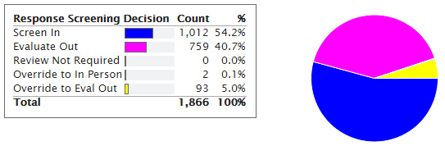
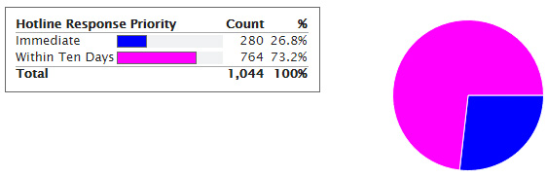
The SDM® Hotline Tools
Screening
Response Priority
Does referral require in-person response?
All referrals
Completed during call
Decision:
  Evaluate out
  Assign
How quickly to respond
All referrals assigned an in-person response
  Some exceptions
Completed during call
Decision:
  24 hours
  10 days (5 in LA)
Notes:
Moving on to the policies and procedures for the individual SDM assessments, we will start with the hotline. Hotline tools are made up of two parts: screening and response priority. The screening assessment is used on all referrals and guides the decision about whether the referral requires an in-person response. It should be completed DURING the call (technically, policy says immediately). For those referrals that will be assigned an in-person response, the response priority section helps guide the decision about how quickly to respond. It, too, should be completed during the call. Completing the hotline assessments during the call helps ensure that the definitions are examined while the reporter is on the phone so that the definitions can guide questions to ask of the caller to get the right information to make the decision.
The graphs show a sample of California SDM counties’ monthly decisions as guided by the SDM assessments. In this sample, 54% of referrals were assigned to in-person response based on screening criteria (left) and about 1/4 were assigned for immediate response (right). Source: SafeMeasures.

Slide 20
Highlights of SDM® Hotline Tools: Version 3.0
Preliminary screening at start of the tool
Definitions focus on caregiver action and impact on child
Response priority trees streamlined
Notes:
Take a look at the new version 3.0 SDM hotline tools. You will see a variety of changes in structure.
Key changes include:
The tools begin with a preliminary screening section.
Definitions are written with a focus on caregiver actions and their impact on the child.
Response priority trees have been streamlined.

Slide 21
Common Mistakes
Creating an unnecessary referral
Attempting to apply criteria when not applicable
Completing additional decision trees after reaching a 24-hour response priority
Not asking “one more question”
DEFINITIONS
Notes:
Based on review of data, case reading, and technical assistance, there are a few common mistakes that have been observed—not often, but enough to mention to help avoid repeating.
While it is required to complete a hotline tool for every referral, it is not necessary to CREATE a referral every time the phone rings. If a referral is created that should not have been created, the screening and response priority tools are applied to an illogical situation and may yield illogical results. What are reasons you would not create a referral for a phone call? (Information on ongoing case that does not allege abuse or neglect.) What would you do instead?
Remember that in some situations, you can go directly to the decision section and mark “Review of criteria not required.” What situations would this be? (No child under 18, not in county, allegation in group home or institution.)
When doing response priority, if you do one decision tree that leads to 24-hour, you don’t have to do any more decision trees, even if they are visible. Just scroll to the override section.
The last two issues are related. Paying close attention to the definitions is important. In most instances when the field office disagrees with a hotline decision or case reading results in questioning, the decision is characterized by narrative that leaves the reader wanting one more piece of information to complete the definition one way or the other.

Slide 22
Safety Assessment
Is a child in imminent danger of serious harm?
Initial
Process completed during first in-person contact
Documented within two working days
Review/update
If safety conditions change
Documented within two working days
Close
Close of referral IF not promoting and previously identified with safety threat
Close of case
Notes:
The safety assessment is focused on the question of whether a child is in imminent danger of serious harm. The initial safety assessment is completed during the first in-person contact and is documented within two days. This first safety assessment must be completed on day one of in-person contact even if there is further assessment to be done the next day. The worker must make a decision based on what is known that day, because at the end of the day the child is either removed or not. There is only one initial safety assessment per referral. In some referrals, this will be the only safety assessment, but others will require updates.
During the referral or open case, if safety conditions change, a new safety assessment should be done immediately and documented within two days. Mark the review/update as assessment type.
A closing safety assessment is always required when closing a case. When closing a referral, a closing safety assessment is NOT required if promoting to a case. If a case will not be opened, a closing safety assessment is only needed if the previous safety assessment had one or more safety threats marked. Closing a referral without opening a case MUST have a safety assessment with no safety threats. This makes sense. We should not discontinue contact with a family if a child is in immediate danger of serious harm.
Note to trainer: Some exceptions exist, and these should be documented. For example, a family is moving out of state and the worker connected family to CPS in new state and a case will be opened there, but the California referral will be closed.

Slide 23
Highlights of the SDM® Safety Assessment: Version 3.0
Safety threats decreased by three
Safety threats and household strengths/actions of protection focus on caregiver actions and their impact on child
Safety decisions structured for efficiency
Caregiver complicating behaviors
Notes:
The revised version of the safety assessment has undergone some significant changes.
Safety threats related to domestic violence and caregiver substance abuse, mental health, and developmental disability have been removed and placed in a new section of caregiver complicating behaviors.
The focus is on caregiver actions/inactions and their impact on the child.
The safety decision has been structured throughout the tool for efficiency of completion.

Slide 24
The SDM® safety assessment: What are we worried about?
Is there imminent danger of serious harm?
SAFE
NO
YES
Are caregivers able to take protective actions?
Safe With Plan
Create Safety Plan With Family
YES
UNSAFE
NO
Notes:
Say: Here’s a graphic look at the presumptive decisions for the safety assessment. The assessment first asks the question: Is there imminent danger of serious harm? If the answer is no, the tool’s presumptive decision is “safe.” If the answer is yes, a second question is asked: Are caregivers able to take protective action to control the danger? If yes, a safety plan can be developed with the family and the tool’s decision is “safe with plan.” If no, the tool’s decision is “unsafe” and immediate action will be needed to protectively place the child or children.

Slide 25
Common Mistakes
DEFINITIONS
Incomplete information gathering
Insufficient exploration of safety plan options
Confusing case plans and safety plans
Completing on wrong household
Notes:
Common issues with the safety assessment begin with definitions. Most often this is in the direction of marking as a safety threat a situation that is NEAR the safety threshold, but does not meet it. This can cause confusion, if the worker is attempting to close a referral without creating a case and has a safety threat marked that really should not be marked. The worker wonders why the SDM system requires keeping a case open in that situation. The issue is that the item really is NOT a safety threat.
Another issue is completing a safety assessment without adequately examining all safety items. The advanced safety training will help guide workers about how extensively to pursue each item under different circumstances. While it is not always necessary to ask in-depth questions, if there are indicators that a safety threat may be present, it is necessary to conduct thorough interviews and observations, contact collaterals, and pursue the question until the safety threat is clearly ruled in or out. The supervisor should not be left wondering whether a safety threat does or does not exist.
If a safety threat was identified, at times there has not been a clear indication that the worker considered safety plan options before proceeding to a removal decision.
Safety plans have often been vague, lacked monitoring requirements, and have included elements that are really more like case plan interventions. Safety plans should address the immediate threat, not the underlying issue.
Finally, safety assessments are occasionally completed on a custodial parent when the allegation is related to the non-custodial parent, or on a temporary caregiver rather than the legally responsible parent and alleged perpetrator. For example, a fight between mother and teenage son resulted in a physical abuse allegation. By the time of the response, the son has gone to stay with grandmother for a few days. The worker has completed a safety assessment on the grandmother. They should assess the safety of the MOTHER. The temporary arrangement with the grandmother may be part of a safety plan.

Slide 26
The SDM® Risk Assessment
What is the probability of future harm?
Required on substantiated and inconclusive referrals
At CLOSE of investigation
Decisions
Promote
Do not promote
Notes:
The risk assessment provides information on the probability of harm to any child in the household by the adult caregivers in the household. It is required on substantiated and inconclusive referrals. Some counties also require a risk assessment to be completed on unfounded referrals. Risk assessment should be completed at the close of the investigation. Since a major decision guided by the risk assessment is whether or not to promote or close, the risk assessment should generally be completed prior to that decision. Of course, if a child remains in protective placement and so will have a case opening, risk should be completed after gathering enough information to complete all items, even if the case has already been “opened” according to CWS/CMS.
Note to trainer: The policy language was written to reflect a decision sequence that assumed that the actual case opening would occur after the risk assessment. In practice, most counties complete the “opening” in CWS/CMS the same day as the removal. The policy should not be interpreted to suggest that a worker should complete a risk assessment the same day as the removal. Doing so most likely will result in underestimating risk because there is insufficient time to thoroughly examine many items.

Slide 27
Risk Assessment: How worried should we be?
What is the likelihood of future abuse or neglect?
LOW
close
MODERATE
HIGH
open
VERY HIGH
Notes:
The risk assessment estimates the likelihood that maltreatment of any severity will occur in this family in the future. This information is used to guide two key decisions: whether or not to open an ongoing services case after the investigation and, if so, what service intensity to provide.
Because it is research-based, the risk assessment tool does not require a comprehensive list of every conceivable variable. Instead, it is limited to a set of items that have a demonstrated relationship with actual case outcomes. The medical profession is an example of another application for this type of tool. For example, breast cancer researchers have identified a set of three variables that are most important to risk among patients with an identified breast tumor. Knowing these three items provides all the vital knowledge a doctor needs to discuss the most appropriate treatment options based on the risk of the specific tumor.
Likewise, in CPS, there are thousands of pieces of information we can know about a family. However, to estimate the likelihood of future maltreatment, we can limit the list to items with demonstrated relationships to actual outcomes. The tool also focuses on items that are likely available to a worker at the conclusion of an investigation. There is more information available than we had at the first face-to-face contact, but less than we will know six months after case opening. Finally, the tool incorporates as many concrete and easily observable items as possible (about half of the items). This increases the reliability of the assessment.

Slide 28
Highlights of the SDM® Risk Assessment: Version 3.0
Single-stream format
Addition of secondary caregiver items
Item weights adjusted for validation study
Structure of mental health and substance abuse items similar in format
Notes:
The risk assessment has undergone several significant changes, which include:
A single-stream completion format for both abuse and neglect indices
Addition of several secondary caregiver items
Changes in weights in response to findings of the validation study
Similar structure for mental health and substance abuse items

Slide 29
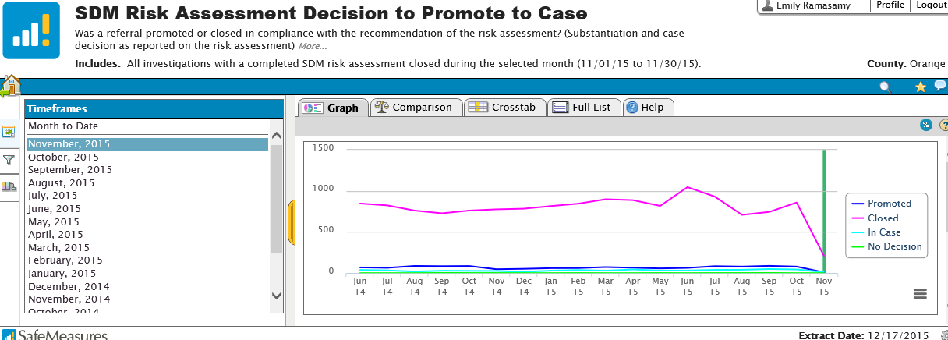
Impact of Revalidation Study
Revised Overall Risk Classification by CPS Involvement During Standardized 18-month Follow-up Period
More families classified as moderate and low risk
Focus on a smaller percentage of families without compromising child safety
Evident change suggests that, by and large, workers are completing tool accurately
Notes:
This SafeMeasures report shows risk levels for all families. The pink line is low and moderate risk combined and the blue line is high and very high risk combined. What do you see? (about evenly divided until about February, then more low and moderate; very stable before and after change). This graph also suggests a remarkably consistent aggregate level finding. Most counties didn’t make significant announcements about the new risk tool, yet across hundreds of workers and thousands of families, there was instant change the moment the new tool was released. Along with the amazing stability over time, this strongly suggests that workers are not just making up risk assessment answers in random ways.

Slide 30
2013 California Risk Validation Results
N = 11,444 substantiated/inconclusive investigations between July 1, 2010, and June 30, 2011;
18-month follow-up period
Notes:
The original California risk study was done in 1998, and the resulting tool was used from 1999 to 2005. Typically, CRC conducts a revalidation about every five years. California has completed four validations of the risk assessment. Here are the most recent validation results from 2013. This is important in learning whether slight adjustments are required.
It is good news that, using the new tool, fewer families will be classified as very high or high risk if these categories continue to be associated with significantly higher rates of subsequent investigation, substantiation, and foster care placement. This graph shows the outcomes for families classified using the new risk assessment tool. As you can see, families classified as high risk are more than three times as likely to have a subsequent investigation than low-risk families, more than four times as likely to have a subsequent substantiation, and more than eight times as likely to have a subsequent foster care placement. This assures us that while fewer families will have cases opened for services under the new assessment, we will be targeting resources to families who need them most and who are most likely to benefit.
DIGGING DEEPER: Revalidation studies also take advantage of increasingly systematic record-keeping. Some important items may not work in early tools solely because case records did not systematically report that item. Also, revalidation studies are generally prospective, so they reflect use of the tool in the field rather than case record reviews.
The most recent California risk revalidation study was conducted in 2013, and the current tool is the result of this study. You can see that the tool is very robust. The slide shows results for re-referrals, re-substantiations, and placements. You can see that for each outcome, as risk level goes up, the chances that a family will have those outcomes increases significantly.
For example, there is about an 84% chance that a low-risk family will not have a new investigation over the next two years (rate = 16%). There is a 95% chance that they will not have a new substantiation (rate = 5%), and it appears that even if there is a substantiation, it is extremely unlikely to be a serious situation, because only about 1% of low-risk families have a child end up in foster care within 18 months.
In contrast, a very high-risk family has about a 58% chance of HAVING at least one new investigation. Many of these families, in fact, will have multiple referrals in the next 18 months. Almost one quarter of them will be substantiated at least once more, and 16% will result in a foster placement.
If you had the resources to serve all families, you would not need to choose. But if you only have enough workers to serve either a low-risk family or a high-risk family, and your goal is to prevent future harm, which family would you select? Why?
TRAINER NOTE: Desired response is to serve the high-risk family because services may prevent future harm. For low-risk families, there is little to prevent, although referrals to community support services for identified needs should be made.
DIGGING DEEPER: For background, you may wish to become familiar with the risk study. You can download a copy at docs.sdmdata.org. The user name is “california” and the password is “training.” Select Trainer Resources and select Risk Revalidation Report 2013. A new validation study was completed in 2013, and an updated risk assessment was introduced statewide November 1, 2015.

Slide 31
Common Mistakes
Assessing wrong household
Completing when not required
Completing with insufficient information
DEFINITIONS
Not engaging high-risk and very high-risk families in services (especially if inconclusive)
Providing services to low- and moderate- risk families with no unresolved safety threats
Notes:
The most common issue with the risk assessment is completing it on the wrong household. As mentioned earlier, assessing risk on a household that is not of concern in the current referral often yields a low or moderate risk level, which suggests the referral should be closed. This can mistakenly cause a missed opportunity to intervene in a way that can protect the child in the long run. For example, if the child lives with mother, but the allegation is against father, and the mother’s risk level is low, resulting in the case being closed, we miss an opportunity to work with father to help him become a better parent. What can happen as a result? (He continues to maltreat this child and/or other children; department gets additional referrals and has to investigate again; mother is in terrible position of having no support to protect her children).
Time is sometimes spent completing risk assessments on unfounded referrals even when not required by the county.
Several items are often completed without any evidence that the questions were asked. What items would you imagine are least often well-supported in the narrative? (Abuse as child; caregiver characteristics.)
Sometimes definitions are missed. The most common is mistaking primary and secondary caregiver, or mistakes in counting prior history.
A high percentage of high-risk and very high-risk families, especially for inconclusive referrals, do not have cases opened for service. This is okay if a good clinical reason exists, but there is often little effort documented to even try to engage these families or to ensure that they get services from another source. The result is that they will likely be re-referred.
A smaller issue is opening cases on low- or moderate-risk families where there are no safety threats. This uses resources that should be directed toward higher-risk families, and using resources for lower-risk families is not likely to make a difference in child safety.

Slide 32


The Difference Between Risk and Safety Threat
RISK
SAFETY THREAT
Notes:
Here is another way to think about the difference between safety threat and risk.
High (or very high) risk means you are in a situation where the chances of an adverse event happening are unusually high, such as places on the road where they post deer crossing signs. It does not mean you need to slam on your brakes—it just means to be extra cautious.
Danger means that there is a deer on the road! An accident has just happened, is happening, or is about to happen unless someone changes course immediately.

Slide 33
Integrating What We Learn From Safety and Risk
Safe
Low/Moderate Risk
39.2%
Safe With Plan
Low/Moderate Risk
13.5%
Unsafe
Low/Moderate Risk
1.7%
Safe
High/Very High Risk
20.1%
Safe With Plan
High/Very High Risk
13.3%
Unsafe
High/Very High Risk
12.2%
2014 Combined California Management Report N = 82,047
Note: Does not represent all referrals because risk is often not determined for unfounded reports.
Notes:
Say: Let’s take a look at what we can learn about how to intervene with families when we look at the intersection between the SDM safety assessment findings and the SDM risk assessment findings. In California, we combined safety and risk assessment results to see where families tend to be across the risk AND safety continuums.
Trainer Note: Walk participants through each square. Transition to how these results inform how we work with families.
One very important point must be made before practicing the risk assessment. Often in CWS, risk and safety are used interchangeably. In the SDM model they are very different, but related, concepts. Safety is the immediate danger of serious harm; risk is the probability of future maltreatment of any severity. Data reveal that, while related, each tool is measuring something different.
We see that among families who are safe, there was the highest proportion of families at low risk. Conversely, removals (unsafe) involved mostly high-risk and very high-risk families, but they did occur among low- and moderate-risk families.
This illustrates why it is vital to do a safety assessment and not simply use risk level to decide whom to remove. As risk increases, so does the proportion of families experiencing removals. High-risk and very high-risk families are included among those who were assessed as safe, and others were assessed as “safe with a plan” using a safety plan. Again, this is why risk is not a basis for removal. So safety and risk are related, but different.
It is also important to note that since the risk tool is validated and safety correlates well with risk, this adds support for the validity of the safety tool.

Slide 34
Triaging From Safety and Risk Assessments
Safe
Low/Moderate Risk
Do we need to be involved at all?
Safe With Plan
Low/Moderate Risk
Is the plan working?
Unsafe
Low/Moderate Risk
Is a quick return home possible?
Safe
High/Very High Risk
What preventive measures can we take?
Safe With Plan
High/Very High Risk
We will need to see a plan working longer
Unsafe
High/Very High Risk
We need to establish sustainable safety in home before return
Notes:
Say: This intersection can help us think about the intensity and manner in which we will work with families.

Slide 35
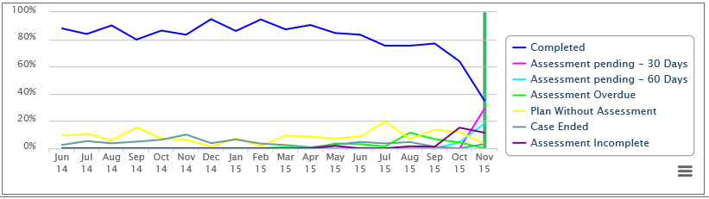

The SDM® Family Strengths and Needs Assessment
What should case plan focus on?
Open cases
  Initial: prior to first case plan
  Review: prior to each case plan
    Voluntary: 30 days prior
    Court: 65 days prior
Up to three priority needs for adults and all child needs must be addressed in the case plan.
Notes:
The FSNA is only completed on open cases. The first FSNA should be done prior to the first case plan, and reviews are done prior to each subsequent case plan. When SafeMeasures looks for completed FSNAs, it first looks for the case plan. If a case plan is found, it looks back 30 days for a voluntary case and 65 days for a court case to see if an FSNA was done during that window. If so, it is considered timely completion. The graph shows a steady trend in completion of the FSNA during 2014 and early 2015, though rates continue to be behind rates of completion of the safety and risk assessments. In addition, the graph shows a drop-off in completion rates beginning in the summer of 2015.
The goal of the FSNA is to examine, in a fairly comprehensive way, what could be underlying dynamics that contribute to the risk of maltreatment. Identifying the most pressing needs is used to focus the case plan. The case plan BEGINS with this focus on priority needs and strengths, but case planning will require more clinical judgment to select objectives and services to address priority needs based on the unique family situation. The advanced case planning training is aimed at guiding the use of the FSNA in case planning.

Slide 36
Highlights of the SDM® FSNA: Version 3.0
Cultural and household context
Definitions linked to safety threats
Completion without “scores”
Addition of trauma domains in caregiver and child sections
Notes:
The family strengths and needs assessment has undergone a dramatic redesign. Focus is on encouraging the use of the FSNA structure as a prompt for a shared assessment with caregivers and youth.
Changes include:
A cultural and household context section for both caregivers and youth
Definitions of domains are linked to relevance to safety threats
The domains are completed without “scores”
More neutral language for domains
Addition of trauma domains for both caregiver and child

Slide 37
Common Mistakes
DEFINITIONS
Completing without gathering enough information
Case plans that don’t address priority needs
Case plans that go beyond priority needs
Not addressing child needs
Notes:
As with all tools, a common issue with the FSNA is skipping a careful review of the definitions before marking items. This is related to attempting to complete the FSNA without a thorough interview with family members.
The other issues are legitimate artifacts of a computerized case plan document that was not developed to integrate with the SDM system. As a result, case plans often fail to address priority needs. Just as often, they go beyond priority needs. It’s too easy to just click from the drop-down menu! Finally, child needs are often expressed simply as “age-appropriate child services” rather than specifically addressing identified child needs.

Slide 38
Needs, Risk, and Safety Threats Are Different
Needs
Risk
Safety Threat
May be related to danger (safety threat)
May be related to risk
May need to be addressed on case plan
Indicates likelihood of future maltreatment
Imminent threat of serious harm
Notes:
The terms needs, risk, and safety threat are often used interchangeably in child protection. However, when using the SDM system, each of these terms has an important, distinct meaning.
A safety threat is about the short term. When we talk about danger in the context of the SDM system, we are looking for serious and imminent threats to a child. Serious means the harm would require medical or mental health attention or emergency services. If the social worker does not think the threat can be contained, he/she would not leave the child in the home. Imminent means the social worker reasonably expects that harm will occur in the next week or month. This is not about “someday.” Danger is related to safety. The SDM system defines safety as protective actions taken by the caregiver that mitigate danger and are demonstrated over time. California workgroups have defined the opposite of safety (danger): a “safety threat.” A social worker’s understanding of a family’s safety may change as he/she learns more about a family (e.g., on Day 1, he/she may not know about the mom’s substance use but may discover it on Day 10) and as the family changes (e.g., on Day 10, the mom kicks her boyfriend out of the house). In the SDM system, social workers assess safety when they first meet a family and then assess it again whenever their understanding of the family’s safety changes. Whenever a social worker is considering whether a child should be removed from the home, a new safety assessment should be completed.
Risk is about the long term. Instead of serious and imminent harm, we are asking about the probability that any child maltreatment will occur in the next one to two years. That may sound like we are trying to predict the future, but we are really trying to assess the odds, using a research-based actuarial assessment to help us.
Needs are about underlying conditions in the home—which may contribute to safety threats or risk factors, or may be utterly irrelevant. When considering strengths and needs, we are talking about the family’s capacity to provide for the child’s ongoing safety and well-being.
These terms in the SDM system are related to the prioritization of information. We start with danger (and the safety assessment) in order to learn whether there is a problem we need to address right now. Then, we take a little more time to consider risk (and the risk assessment), because risk is farther in the future. Needs (and the family strengths and needs assessment) are at the very end of our list because they help us decide what to do to address any safety threats or risk factors we may have identified.

Slide 39
Reunification Reassessment
Can child go home, or should the permanency plan change?
Open cases with at least one child in substitute care
Prior to case plan update (65 days)
Decisions
Return home
Continue family reunification (FR)
Terminate FR
Notes:
If a child was removed, then at each review a reunification reassessment is the FIRST step in the review process. It will guide the decision about whether to recommend return home, continued reunification efforts, or a change in the permanency plan goal. It is used if there is at least one child in out-of-home care.
Like the FSNA, when SafeMeasures examines completion rates, it looks for a current case plan. Then it looks in the 65‑day window prior to the case plan to see if a reunification reassessment was done. (FR is always court‑involved, so 65 days is the window.)
Note to trainer: If other children are in placement, it is not necessary to complete a risk reassessment in addition to the reunification reassessment. Just use the risk level from the reunification reassessment.

Slide 40
Highlights of the SDM® Reunification Reassessment: Version 3.0
Progress definitions focus on behavior change
Weights based upon revalidation study
Visitation section streamlined
Safety assessment focuses on prior AND current safety threat assessment
Notes:
Key changes to the reunification reassessment tool include:
Progress item is focused on behavioral changes demonstrated over time
The visitation section has been streamlined
The safety portion of the reunification reassessment focuses on prior and current safety threat assessment and planning

Slide 41
Common Mistakes
Incorrect initial risk value
Lacking documentation for visitation
Using incorrect decision tree
Considering information outside of the current review period
Notes:
Case reading reveals that the most common mistakes on the reunification reassessment include starting with an incorrect risk value for R1. This should always be the most recent risk assessment level (not a risk reassessment level). Another common issue is that there is often little or no documentation to explain the ratings for visitation quantity or quality. Occasionally, a worker selects a decision tree for the wrong age of the child. Remember, it is based on the age of the child at the time of removal, not at the current time.
Finally, assessment is sometimes based on facts that are not true for the current assessment period. For example, a failure to engage in services previously should not be considered if the family engaged in services during this period. Base this assessment on the family’s overall participation during the CURRENT review period.

Slide 42
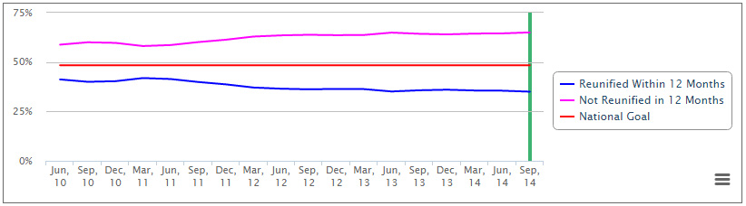
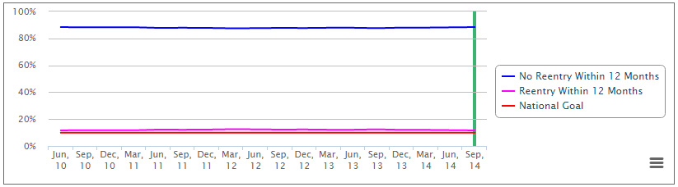
CFSR C1.3
CFSR C1.4
Notes:
After a period of some improvement in timely reunification measures, over the past few years, trends show that workers have reunified a lower percentage of children within the first year. What would we see to suggest that this is an improving trend? (If returning children does not increase the number of children who re-enter care.)
(CLICK)
Fortunately, the evidence shows that rates of re-entry were NOT increased during a similar timeframe. This suggests that good decisions are being made about WHICH children to return home within the first year.

Slide 43
The SDM® Reunification Reassessment is Related to Decreased Rates of Foster Care Reentry
Compliance With SDM® Reunification Reassessment
12-Month Foster Care Reentry Rate
N = 2,327
  Wagner, D., & Bogie, A. (2010). California Department of Social Services validation of the SDM reunification reassessment. Retrieved from http://www.nccdglobal.org/sites/default/files/publication_pdf/crr_validation_report.pdf
Notes:
As a result of frequent and extensive testing, we are confident in the efficacy of our assessments. A 2010 test of our reunification reassessment in California shows that greater compliance with the components of the assessment strongly correlated with reduced rates of reentry into the foster care system.
These results help answer the question: Does the SDM reunification reassessment help social workers identify children who can be successfully reunified before that decision is made? In this study, social workers evaluated three separate reunification components: reunification risk, parent visitation acceptability, and home safety. In a sample of 2,327 reunified children, all three assessment components demonstrated a significant relationship to reentry in the expected direction; a positive social worker evaluation was associated with a much lower reentry rate. Sample child cases where all three components met standards had a much lower reentry rate than cases where standards were not met for all three components (i.e., cases in which the SDM® reunification reassessment did not recommend reunification).
The study confirms the assessment’s predictive validity and suggests that the assessment has a real impact on improving permanency for children and families.

Slide 44
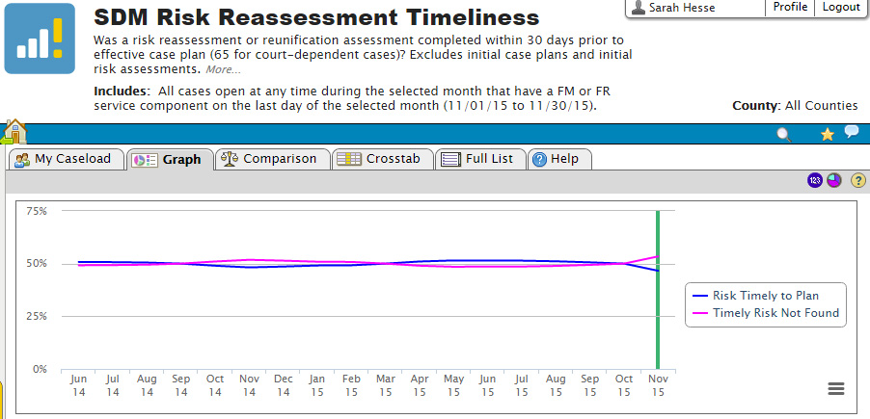
The SDM® Risk Reassessment
What is the probability of future maltreatment?
Open cases with all children in home
Prior to case plan/closure
Decisions: Close or continue FM
Notes:
The last assessment is the risk reassessment. It also asks the question of probability of future harm. It is used with open cases in which all children are in the home, and should be done as the first step in a review process. Thus, when SafeMeasures looks for risk reassessment, it will look for new case plans or case closures, and then will look in the 30‑day (voluntary) or 65-day (court) window prior to the new case plan or case closure to see if a risk reassessment was done. Low- and moderate-risk cases should be closed unless there are unresolved safety threats. High- or very high-risk cases should remain open.
The graph shows modest increases in completion rates, but again, completion of the risk reassessment lags behind completion rates for the initial risk and safety assessments.

Slide 45
The SDM® Risk Reassessment Is Completed at Regular Intervals
What areas of needs and strengths should be prioritized in the case plan?
Should the case remain open or be closed (for in-home cases)?
Family Strengths and Needs Assessment
Family Risk Reassessment
Notes:
As a reminder, the family risk reassessment is an assessment completed at regular periods in the case review process and is designed for in-home cases.
Reassessments provide an opportunity to measure progress and make decisions about whether to close a case or continue to provide services. If the case will remain open, the new risk level guides the continuing service intensity according to contact guidelines.

Slide 46
Highlights of the SDM® Risk Reassessment: Version 3.0
Progress definitions focus on behavioral change
Weights of some items informed by revalidation study
Notes:
Key changes in the 3.0 tool include focusing progress definitions on behavioral change and adjustment of item weights.

Slide 47
Common Mistakes
DEFINITIONS
Missing assessment
Not completing safety assessment prior to closing
Notes:
Definitions are a key issue in risk reassessment as well. Pay particular attention to aspects of the definition that describe which time period to consider. The biggest issue supervisors should address is just getting risk assessments done when they are supposed to be done!
Finally, remember that if the case is going to be closed, a closing safety assessment ought to be done to confirm that there is no imminent danger of serious harm before walking away.

Slide 48
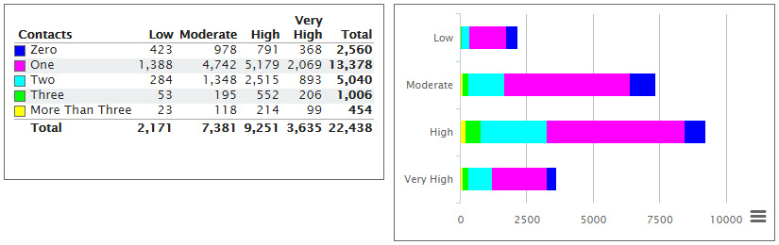
Contact Guidelines
The higher the risk, the more contact is needed to ensure safety and promote change.
Notes:
In addition to the assessments themselves, the SDM system contains an often overlooked element called contact guidelines. Do workers spend the same amount of time on each case each month? (No.) What influences how much time they spend? (Crisis, court, “squeaky wheel,” etc.) The SDM system suggests that we ought to be strategic about how we spend our time. The higher the risk, the more time we should spend with a family. The ideal situation is to visit very high-risk families four times a month, three times for high-risk families, twice for any moderate-risk cases that are open, and once per month if a low-risk case is open. Of course, visits beyond the required one visit per month can be made by a social work aide or collateral as well. We know workers can’t make all the recommended visits. But if they are making extra visits, it should be with higher-risk families. And if they ever miss a family in a month, wouldn’t you rather they miss a low-risk family than a very high-risk family?
You can use SafeMeasures to track how workers in your unit are distributing their time. Overall, the extra visits are more likely to go to high-risk and very high-risk families. We’ll be going into this in greater detail later.

Slide 49


Notes:
Before wrapping up our review of fundamentals, we need to emphasize the most fundamental of fundamentals.
Definitions. As a supervisor, you must be the expert on definitions. You must expect your workers to use the definitions.

Slide 50
Definitions Matter!
Use item definitions to determine whether the information about the family matches the item being considered.
Read to the period.
Examples are just examples and not all-inclusive lists of conditions.
Be aware of:
“AND”
“OR”
“and/or”
When unsure, ask others and use clinical judgment.
“Unasked” is different from “unknown.”
Use common sense.
Notes:
Say: Here are some tips for using definitions in the SDM model.
First, “read to the period” means read the entire stem of the definition. One common mistake is taking a phrase or a piece of a definition and then applying the definition inappropriately.
Second, as in the definition of “historical information,” when you see a big AND, it means that the circumstances stated on both sides of the AND must be true in order for the definition to apply. When you see a big OR, it means one or the other circumstance must be true in order for the definition to apply.
Third, remember that information that has not been asked about is different from information that is unknown. If information is unknown, the definitions should be applied in a manner that is focused on child safety.
Fourth, the purpose of examples in the definitions is to offer an illustration about the threshold, nature, severity, etc., of what is intended by the definition. If an example fits your situation, it does not mean the whole definition applies. Conversely, if your situation is not specifically listed in the definition, it does not mean the definition does not apply.
Fifth, use your professional judgment and common sense. For example, if the definition says that the child must be 10 years old, if the child is a few days or weeks shy of 10 years old, he/she is substantially 10.

Slide 51
Exercise: Fun With Definitions
Notes:
Because definitions are so important, we are going to do our first exercise with definitions.

Slide 52
Participant Guide
Select section(s) based on what you supervise
For each item:
Read narrative
Compare to definition
Was it marked correctly?
If not, why was it incorrect?
Notes:
Turn to page 7 in your participant guide.
Note to trainer: If participants are all from one work unit type (e.g., all ER), direct them to that section of the exercise. If they are from different units, have each type of unit supervisor sit together. Have them complete just the section related to their unit.
You will read the narrative, look up the definition in your P&P Manual, and then mark whether the worker correctly applied the definition in marking the item. If it was incorrect, provide a brief explanation in the final column.

Slide 53
Example (Risk Assessment)
# | SDM Item | Narrative | Supervisor Decision | If Incorrect, Why?
A | 8. Age of youngest child in home 2 or older | The family includes three children, ages 7, 5, and 6 months, but the 6-month-old is in foster care as a result of this referral. | ○ Correct ○ Incorrect
8. Age of Youngest Child in the Home
Identify the current age of the youngest child presently in the household where the maltreatment incident reportedly occurred. If a child is removed as a result of the current investigation, count the child as residing in the home.
Notes:
For example, on risk assessment item 8, the worker marked “a, 2 or older.” According to the narrative, there is a 6-month-old who is currently in foster care. Look at the definition for this item on page 76 of the P&P manual. This item is incorrect, according to the definition because children removed as a result of this investigation should be included in determining age of youngest child.
Note to trainer: Allow approximately five to ten minutes for participants to finish.

Slide 54
Example (Risk Assessment)
# | SDM Item | Narrative | Supervisor Decision | If Incorrect, Why?
A | 8. Age of youngest child in home 2 or older | The family includes three children, ages 7, 5, and 6 months, but the 6-month-old is in foster care as a result of this referral. | ○ Correct ● Incorrect | If a child was removed as a result of this investigation, he/she should be included, so the 6-month-old should be counted.
N5. Age of Youngest Child in the Home
Identify the current age of the youngest child presently in the household where the maltreatment incident reportedly occurred. If a child was removed as a result of the current investigation, count the child as residing in the home.

Slide 55
Debrief
Notes:
Note to trainer: If all participants are from one unit type, review all items for that unit. If participants are mixed, pick an example or two from each unit type to report out.

Slide 56
Common Mistakes and How to Fix Them
Notes:
As we reviewed fundamentals, we discussed some of the common mistakes workers make when learning to use the SDM system. As a supervisor, one of your tasks is to spot mistakes and correct them. Turn to page 12 in your participant guide. This section describes some of the common mistakes we already mentioned, plus a few more, and for each one provides some ideas for ways you can respond.

Slide 57
Process of Implementation
Improved outcomes
Time
Guide decisions
Accurate completion
Complete assessments
Family engagement
Notes:
Keep in mind that every worker will go through a developmental process as he/she learns to use the SDM assessments. The foundation is family engagement skills. Without this foundation, it’s unlikely that workers will ever succeed at getting accurate information to complete assessments, nor will they succeed at engaging families in appropriate services.
The first stage of SDM competency is just figuring out which SDM assessment to do on which family and when.
The second stage is gaining competency in applying definitions accurately to a variety of unique circumstances. This also includes writing clear and concise narratives that support the assessments.
The third stage is really settling in to letting the SDM system guide decisions. When this takes place, outcomes are very likely to improve.
As you look at some of these common mistakes, you will see that some of them are about earlier stages and some are about later stages. Know your workers, and help them achieve mastery one step at a time.
When you spot an error, there are many ways you can respond. One is to ignore it. One is to get mad. One is to just fix it on your own. We’d like to encourage a more useful approach, which is to use errors as learning opportunities. Rather than just fixing THIS incident, use the opportunity to help the worker understand the correct approach. Then you won’t have to keep fixing the same errors!

Slide 58
A Tale of Two Supervisors
Two supervisors review a screener narrative that assigned a referral based on a domestic violence incident.
Supervisor A
Knows that SDM screening criteria were not established, but lets it go through.
Supervisor B
Asks worker about information on location of children, frequency, severity, impact on children, etc., using SDM definitions. Coaches on ways to get needed information.
Notes:
For example, here are two responses to a common error. Which supervisor is building competency?

Slide 59
Another Tale of Two Supervisors
Two supervisors review a safety plan that doesn’t make clear what the threat is, uses services that won’t start for weeks, and has no monitoring plan.
Supervisor A
Knows how busy the worker has been, and reasons that the case plan will get written up soon anyway. Besides, it’s obvious that mom needs parenting classes.
Supervisor B
Helps worker specify the threat and generate ideas for possible safety interventions. Worker returns to family to develop updated safety plan that addresses immediate threat and includes monitoring.
Notes:
Try this one.

Slide 60
Yet Another…
Two supervisors review a court report recommending return home. There is no information about visitation in the report, but it is marked “acceptable” on the SDM reunification reassessment.
Supervisor A
Makes sure spelling and grammar are correct and all required spaces are filled in. Has heard worker talk about family for several months and knows worker was working very hard to get family ready for reunification.
Supervisor B
Asks worker about quantity and quality of visits. Does not approve until this information is included in report and matches assessment. Uses opportunity to encourage worker to talk to families about expectations for visits and to use visits as opportunities to demonstrate skills.
Notes:
And this one…

Slide 61
Basic Principles
Understand the decision point
Look up the policy
Use the definition
Be consistent!
Notes:
You may encounter errors other than those listed here. Having a few basic strategies in your tool kit will solve most of the issues you might face.
First, understand the decision point. CLICK HYPERLINK.
Rather than guess at the policy, look it up.
Rather than guess at the definition, look it up.
Most importantly, be consistent. Set your expectations for worker use of the SDM system and don’t allow exceptions.
Note to trainer: Go over several examples from participant guide pages 12-19. If all participants are from one unit type, use only that unit. If participants are mixed, pick an example from each. Ask what supervisor A would do and what supervisor B would do. Ask for other mistakes they come across frequently and when they have done/could do about them.
This slide ends the common mistakes section. Proceed to the next section on case conferences.

Slide 62
Case Conferences
Notes:
In this next section, we’ll focus on one of the most common worker/supervisor interactions: the case conference.

Slide 63
Types of Case Conferences
Informal
“Have you got a minute?”
“I see you haven’t eaten in days and were about to have lunch, but this will only take a minute.”
Formal
1:1 case-specific
1:1 supervision
Internal group
Multidisciplinary group
Notes:
Case conferences come in all shapes and sizes. Informal conferences can happen anywhere, anytime.
Formal conferences can be for the purpose of individual case processing or individual supervision, or they can be group events. Group events might involve only staff from your department, or might include other professionals and/or the family.
Regardless of the setting, a case conference should have a specific purpose. Typically that purpose is related to a key decision.
The handout lists common central questions that may be the specific purpose for a case conference. When you are in a conference, whether formal or informal, be aware of the central question and which SDM assessment ought to be central to the discussion at hand. The final column lists important questions you should raise as the conference moves toward a conclusion.

Slide 64
Suggested Structure for Case Conference
Focus the conversation on the key questions of the decision point and assessment structure.
Elicit caseworker thinking related to proposed course of action.
Engage in conversation with a focus on the definitions, using the Three Questions structure.
Ask questions that elicit family facts related to definitions and relevant decisions.
Make agreements about additional information needed, conversation, and follow-up steps with family.
Notes:
Say: Whether in formal individual supervision, formal case consultation, or supervisory guidance that occurs “on the fly,” this suggested framework can guide a conversation with a caseworker about these case opening decisions. The full handout is on page 21 in the participant guide.
Use strategies that include the Three Questions and solution-focused questioning strategies.

Slide 65
Three Questions Can Uncover Relevant Details
What is working well?
What needs to happen next?
What are we worried about?
Notes:
For instance, the Three Questions can serve as the framework for supervisory conversations with caseworkers. What are we worried about? What is working well? And what needs to happen next? Although these may seem like simple questions, they help us engage caseworkers in identifying the primary concern for the child and the family’s capacity to address the concern, and possible next steps for alleviating the concern.

Slide 66
Impact on the Child Is a Helpful Construct
Parent
Behavior
Impact on the child
Notes:
In addition to the Three Questions, focusing on the impact of a parent’s behavior on the child can be a helpful construct.
In conversations with caseworkers, you can encourage others to identify the child’s parent(s), the parent(s)’ behaviors, and the impact of these behaviors on the child.
Although the parent may have done something or failed to do something, we are most concerned about behaviors with significant impact on the child.
Imagine that a mother drove home following a night out drinking at the bars. When she arrived home, her children were asleep and safe because their grandmother had been watching them. The next morning, the children noticed that their mother was a little grumpy, but it did not seem to bother them. While the mother’s behavior in itself is worrisome, it has no bearing on child protection because it did not seem to impact the children.

Slide 67
Supervisory Leadership
Keep focus on central question.
If there are disagreements in final decision, review relevant SDM tool completion.
  Which items have agreement? (move on)
  Which items have disagreement?
    Look at facts and definition
    FOCUS discussion here!
If everyone agrees, STILL review tool completion!
Notes:
In conferences (unless it is a specific meeting such as Team Decision Making with a trained facilitator other than yourself), it is important that you demonstrate leadership. Specifically, be sure the conference stays focused on the central question. Too often, conferences go on and on without ever coming closer to a decision. That happens when we lose focus. Bring the discussion back to the central question.
Most often, a conference happens because help is needed to decide a major case action and/or different parties disagree on what action should be taken. These disagreements can become intense, personal, and unproductive. Use the SDM assessment to help everyone focus by first identifying all of the items on the relevant assessment that all parties agree on. This will help build consensus, and will limit discussion to a smaller set of issues. When you have identified the item or items that have a disagreement, read the definition out loud. Ask a representative from each perspective to present the facts he/she feels support his/her application of the definition. Often, someone misunderstood or misread a definition, or was missing an important fact. He or she may be substituting assumptions for facts.
Note to trainer: (OPTIONAL) Click on the “Look at facts and definition” hyperlink to spend time discussing the differences between “Fact, wonder, suspicion, assumption.”
If the issue is not quickly resolved, continue the discussion for a while, but be sure the discussion stays focused on this area. Repeat until all items have been agreed upon. If you can’t get agreement on an item or two, you will have to be the final arbiter.
If everyone agrees on the items but not on the action, consider whether an override is appropriate.
Finally, if you are conducting a routine case conference and there are no disagreements, it is still worth taking a look at the SDM assessment to be sure it accurately represents the family and all points of view.
Note to trainer: This ends the discussion section on case conferences.

Slide 68

Leadership in Case Conferences
Notes:
It’s time to practice a little supervisory leadership!

Slide 69
Scene One
 | Role
A | Worker
B | Supervisor
C | Observer
ROLE-PLAY RULES
Raise hand to “freeze” the role play.
Everyone in group steps out of role to discuss the question.
Trainer will respond.
Two-minute prep
Read circumstances for your character. If applicable, read the presenting question you will take to supervisor.
Look up policy or definition as needed.
Five-minute conversation
Supervisor goal is to correctly respond to situation.
Notes:
You will do two rounds of this exercise, which is on pages 22 through 24 of your participant guide. Your goal will be to lead the focus of the conference to the key question, the relevant SDM definitions, and the facts supporting those definitions.
First, get in groups of three.
Note to trainer: If participants are from different work unit types, have them get in groups with participants from the same type, i.e., a group should be all ER or all FM. If needed, mix a group.
In each group, pick the person who MOST wants to avoid role playing! That person is going to be the observer in both role-play scenes. If you are that person, look on page 25 of the participant guide and familiarize yourself with the observation task. You will be rating the performance of the supervisor.
In each group, one person will begin as the worker and one person will begin as the supervisor. Decide now who will be who.
Now, on pages 22–24, find the scenes for your unit type. Read Scene One and start to get an idea of how to play your role. You will have two minutes to read the scene. Also, based on the scene, look up the relevant SDM policies and/or definitions in advance. A good supervisor prepares for conferences! Use the case conference handout on page 21 for tips on which SDM tool you should be prepared to discuss and some important questions. Workers, be prepared to give your supervisor a little grief … try to get the discussion to irrelevant facts.
Note to trainer: Give two minutes for everyone to read the scene; then give five minutes for the conference.

Slide 70
Scene Two
 | Role
A | Supervisor
B | Worker
C | Observer
ROLE-PLAY RULES
Raise hand to “freeze” the role play.
Everyone in group steps out of role to discuss the question.
Trainer will respond.
Two-minute prep
Read circumstances for your character. If applicable, read the presenting question you will take to supervisor.
Look up policy or definition as needed.
Five-minute conversation
Supervisor goal is to correctly respond to situation.
Notes:
Now switch roles. If you were the worker, you are now the supervisor, and vice versa. The observer stays the same.
Read the circumstances for Scene Two and take two minutes to prepare, including reading the relevant SDM policies and/or definitions. Workers, now is your chance to dish back—try to keep the supervisor off track just a little.
Now begin.
Note to trainer: Give two minutes for everyone to read the scene; then give five minutes for the conference.

Slide 71
Debrief
End of Module #1
Notes:
Observers, how did the supervisors do? Did they remain focused? Did they use definitions? Did they insist on facts?
Note to trainer: If Module 1 is being presented alone, conclude the module by asking participants to state one thing they learned that they will use when they return. If the group will return after lunch, skip this step.
This slide ends Module 1 and the “Leadership in Case Conferences” exercise and case conference section of the module.

Slide 72
Supervisory Chores
Notes:
The next several sessions will discuss typical supervisory chores. We can’t tell you that you don’t have to do them anymore. But we will talk about some tips for doing them that will help make them a little easier.
Note to trainer: If you did Module 1 in the morning and are continuing after lunch, proceed immediately to approving overrides. If you are reconvening the same group, but a day to a week later, start with the roundtable slide and do a brief check-in. Ask volunteers to talk about using definitions or case conferences since the last meeting. If the group has not been together previously, or more than a week has passed, do introductions before doing the roundtable exercise.

Slide 73
Roundtable
What is a word or phrase that describes the “state of SDM” practice in your unit?
What is working well and what needs work in SDM practice in your unit?
Notes:
Note to trainer: You can use this time to allow participants to reflect upon various SDM issues in their unit at the start of each module. The amount of time and specific exercise can vary. It is designed to be flexible so that you can individualize sessions. If sessions are being held back-to-back, you may do only a brief check-in and hide this slide. If the group is reuniting after weeks, you may check in to see how things have gone since last time and whether they’ve tried any of their new skills. You can use the time to recap what has been covered. You also can include an exercise of your own choosing that would highlight a specific issue for the group you are training.

Slide 74
Supervisory Chores
Developmental
Supportive
Managerial/ administrative
Approving overrides
Approving assessments
Correcting mistakes
Monitoring case contacts
Assigning cases based upon risk
Supporting effective reassessment
Notes:
In this module, we will cover some key supervisory chores. These supervisory tasks ensure that assessments are completed accurately and in a timely manner and allow the supervisor to spot areas of caseworker practice development related to use of SDM assessments in practice.

Slide 75
Approving Overrides
Notes:
We’ll move on to another supervisory responsibility in the SDM system: approving overrides. By policy, every override requires supervisory approval. While overrides are rare, it’s important that you have a consistent basis for deciding whether or not to approve a requested override.

Slide 76
Purpose of Overrides and “Other” Options
Balance structure/research AND professional judgment
Account for rare circumstances, unique situations
Decision is NEVER forced
Notes:
Knowing the purpose of overrides (on some tools, the function of an override is served by an “other” item) is key to making good decisions about whether or not to approve them.
While the SDM system has more evidence behind its decision-making process than any other model, including clinical judgment alone, it isn’t perfect. We simply don’t know enough about the complex dynamics of child maltreatment to be 100% accurate all the time. An SDM assessment is not a litmus test or a crystal ball. While it outperforms clinical judgment alone, clinical judgment is still a valuable partner with structured assessments.
An SDM model in California is used with hundreds of thousands of families. To be useful in real life, the tools have to be relatively short. The combination of these two factors means that there will always be a certain percentage of unique situations that simply can’t be captured in a structured tool.
Finally, based on these limitations, it would be ill-advised for a structured tool to force a worker into any particular action when that action is clearly inappropriate based on clinical judgment. So, there are a variety of overrides, and each tool has at least one override opportunity.

Slide 77
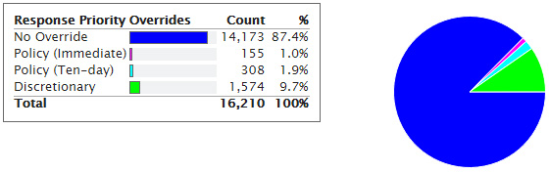
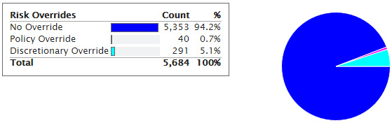
Overrides Are Not Outside the SDM® System
Overrides are an integral PART of the SDM system.
Notes:
While rare, a fairly stable proportion of SDM assessments are processed with overrides. For example, in November 2015, 12.6% of response priority decisions had overrides applied, and a bit under 6% of recommended risk level decisions had overrides. CRC is comfortable with a range of 2–10% in general. When there are too few overrides, the concern is that the tools are being used too mechanically, or that workers are simply stretching definitions. When there are too many, there may be misunderstandings about definitions, or the definitions may need to be revised. Management can look for patterns in the data to identify specific issues.
Overrides are not outside of the SDM system—they are part of it. Workers applying well-reasoned overrides should be supported in their decisions.
Overrides should be safe, legal, and rare!

Slide 78
Overrides/”Other” Responses to Avoid
Does not provide family-based facts, but merely draws conclusion (e.g., risk is lower than scored).
Information should have led to scoring an item differently, eliminating need for override.
Information is irrelevant to the decision at hand.
Information does not lay out a sufficient argument for making a different decision.
Notes:
So what should make you reject an override? General examples of overrides that should be rejected include the following:
An override that doesn’t provide any supporting evidence. Note that webSDM requires that SOMETHING be written, but the computer doesn’t have the intelligence to know whether what is written is good supporting evidence. If what is written just draws a conclusion without providing facts, it’s better to reject it, at least until the worker provides some facts. For example, if a worker lowers the risk reassessment level from high to moderate, and the reason given is “Family is moderate risk,” you need to ask for some evidence.
Also, look to see whether that reason given suggests that an item was mis-scored. If so, scoring the item correctly may eliminate the need for an override. For example, if a family has substance abuse issues, but the worker scored the FSNA as a “B” for substance use, and then scored “D” for FSN11 based on dad’s chemical dependency, reject the override.
A very common override or “other” response is the override being marked, but the documentation is really more of a general note about the case. This should be rejected as irrelevant to the decision.
Finally, if an argument is attempted, but is not a strong argument, reject it. For example, the worker marks a safety threat of “other” and writes that the parents homeschool their children. While homeschooling MAY increase isolation, and in some instances is used to conceal maltreatment, the vast majority of homeschooling does not create a safety threat. The worker would need to add specific facts to explain why homeschooling contributes to a safety threat in this instance.

Slide 79
What makes a good override/”other” response?
It is based on information that:
Does not fit an existing item
Is comparable to existing items
Contributes to the decision at hand
Notes:
On the other hand, good overrides are based on information that wasn’t considered in existing items, but is comparable to existing items and contributes to the decision at hand.
Note to trainer: Take a few moments to look at the table on pages 26-31. Go over several examples relevant to supervisors who are present, based on their program areas. Ask them for examples of good overrides they approved and some they did not approve.

Slide 80
Override Stakes (Examples)
Low Stakes
• FSNA not affecting priority needs
• Increase response priority
• Increase risk from low to moderate or from high to very high
Moderate Stakes
• Screen in
• Decrease response priority
• Add to safety threats
• Increase risk from low/moderate to high/very high
High Stakes
• Evaluate out
• Decrease risk from high to moderate
• First safety threat
Notes:
Not all overrides have the same potential impact on case decisions. For example, adding an “other” response to the FSNA may have no impact on the case plan. Overriding a response priority from 10-day to 24-hour does not put an individual child in potential danger and would only have adverse effects on the agency if it were done so often that the percentage of 24-hour responses creeps up and cripples capacity. Changing risk level has minimal impact when it does not affect the case open/close recommendation. Other overrides have higher stakes. The highest stakes are found when the result of the override is to eliminate contact with the family or to expose the child to potential protective placement, e.g., overriding to evaluate out means no one will see the child. Reducing risk in ways that change the recommendation to close means that services will end. Conversely, using “other” to create the only safety threat creates potential for removal. It is not that these higher-stakes overrides should not be used, but as the supervisor, when reviewing higher-stakes overrides, you will want to be sure the evidence is strong.

Slide 81
Overrides: To Approve or Not to Approve
Notes:
Time to try your skill.

Slide 82
Workbook
Work individually.
Go to workbook section(s) representing work you supervise.
Hotline: p. 29–30
ER: p. 31–32
FM: p. 33–34
FR: p. 35–36
For each item, read the facts that were provided to support the override.
Determine whether you would approve or not approve.
If not approving, explain why.
BONUS: Pick one override you did not approve and rewrite fictional information so that it now supports the override.
Notes:
This is an individual written exercise. You can discuss at your tables—it’s not a test.
Note to trainer: If the group is mixed, it may be helpful to have them sit with supervisors from similar units. Direct them to the exercise related to their unit.
For each item, read the reason the worker gave for making the indicated override. Mark whether you would approve the override or not. If not, explain why.
When you finish the section, if time remains, pick one of the overrides you did not approve and rewrite the reason so that it supports the override. You can make up whatever facts you want as long as they support making the override.
Begin.
Note to trainer: Give about five minutes, or until most supervisors seem done.

Slide 83
Debrief
Notes:
Note to trainer: If all participants are from one unit type, debrief all items from that unit. If the group is mixed, debrief one or two from each unit represented.
This slide ends the “To Approve or Not to Approve” exercise and the section module on approving overrides.

Slide 84
Approving Assessments:
Your Name Is On It!
Notes:
Another supervisory task is assessment approvals. We will review the technical aspect of how to accomplish approvals in webSDM, and then explore an idea for thinking about how much scrutiny you should give to an assessment before signing your name.

Slide 85
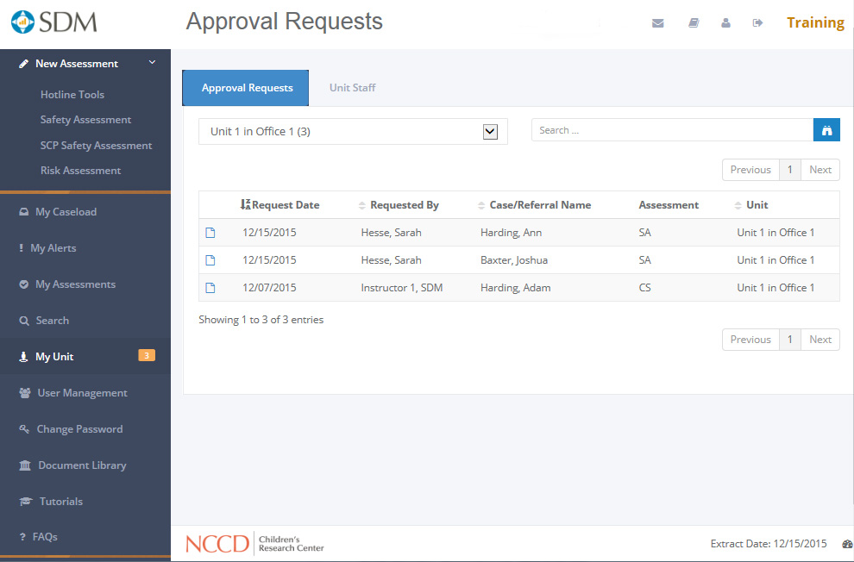
Technical Aspects
Notes:
First, the technical aspects. Here is an image of what the new webSDM approval menu looks like.

Slide 86
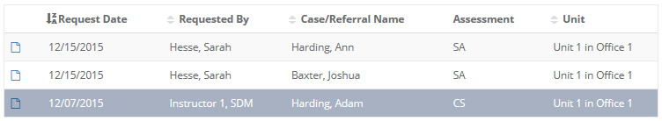
Select Assessment to Review
Notes:
If your box is empty, you can go about other business. If one or more assessments show up, highlight the assessment you want to review.

Slide 87
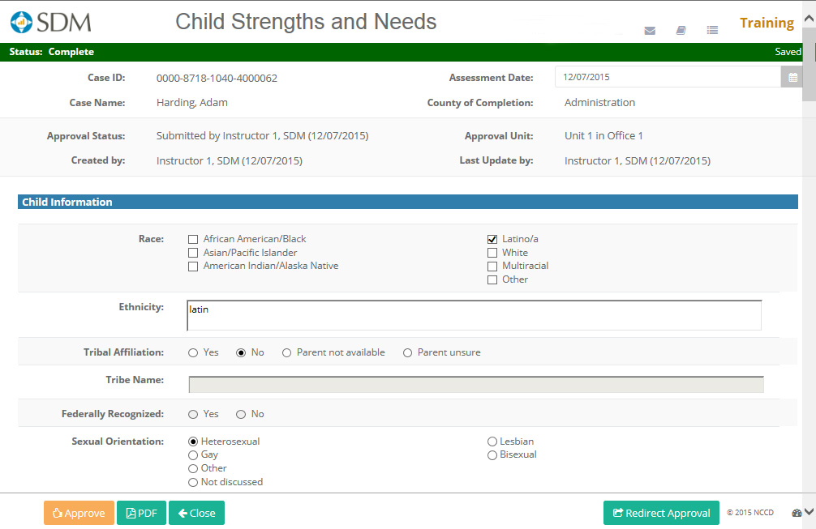
Review the Assessment
(more on this later)
Notes:
We are going to temporarily bypass the actual process of reviewing your worker’s work. We’ll come back to that in a moment.
If you realize that the assessment that showed up in your inbox should have gone to a different supervisor (CLICK—red arrow appears), just click on the “Redirect Approval” button. You will get a list of the units in your county and can click on the correct unit.
If you approve the assessment, select APPROVE (CLICK—red arrow appears).
The assessment will no longer be on your Approval Requests list.

Slide 88
When You Spot a Problem
Option A
(less desirable)
  Make the change
  Explain in supervisory comments
  Approve
Notes:
If you find an error on the assessment, or have a question about the worker’s work, you have two options. The first may be necessary at times, but is not the best option. If the worker is unavailable and you can’t wait for the worker to move the assessment along, you can make the change yourself. Just put in what you believe to be the correct response.

Slide 89
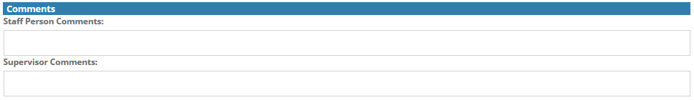
If you modify before approving…
…you need to explain.
Notes:
Scroll to the bottom to the text box labeled “Supervisor Comments” and explain what you changed and why. For example, “Changed 5 to “a” because current allegation is for neglect.” When you’ve made all the changes you intend to make, select the APPROVE button.
It is important to enter any comments before you approve, since the assessment will become read-only after you approve it.

Slide 90
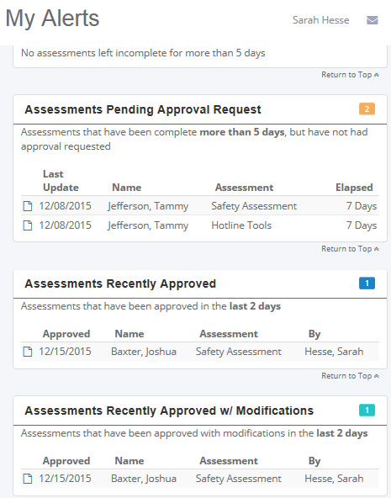
What Your Worker Will See
Notes:
If you modified a worker’s assessment, your worker will be informed via the My Alerts screen. Each worker has an alert section that details approval status. In the box they will have assessments pending an approval requests, assessments recently approved, and (CLICK) assessments you modified before approving. See the green assessment. If the worker opens this assessment, he/she can scroll down to see your comments. Note that he/she does not HAVE to look, but CAN look if he/she wants.

Slide 91
When You Spot a Problem
Option B (better choice)
  Meet with worker to discuss
    Explain issue
    Ask for worker’s perspective
    Use SDM policy and/or definition
Change together, if needed
  Use opportunity to build competence
    Build on worker knowledge/skill
    How can this conversation
      Motivate?
      Inspire pride?
Notes:
A better option for responding to a mistake or question would be to ask the worker to come in to your office/cubicle. If he/she can’t come right away, you can just close the assessment without approving it. It will go back to your inbox. Just open it again when the worker is available.
Tell the worker which item you are not sure about and why. Ask the worker’s rationale for marking it as he/she did. Refer to the relevant SDM policy and/or definition for guidance. It’s possible the worker marked the right response, but wrote a narrative that didn’t include the critical information so it left you stumped. The solution here is working on writing good narrative, but you can compliment the worker’s assessment. The worker could explain why he/she scored it that way and persuade you that he/she is right. Or he/she may realize an error was made. That could mean getting more information before finalizing the assessment. Or it could mean that the two of you change it on the spot. If you make a change, you should explain why.
Note to trainer: webSDM does not keep each edited version, but an audit trail is created about who made a change, when, and what was changed. If time allows, have a discussion about the implications of making edits. There are good, legitimate reasons, and there are not-so-good reasons. Transparency is key.
In any case, rather than just fixing one error, use this opportunity to build worker skill. The choice is yours—fix mistakes one at a time and fix the same mistake over and over, or take a little more time and build a competent staff who will need less hand-holding in the months and years to come.
Note to trainer: Ask for examples of instances supervisors have asked workers to make a change. For new supervisors, ask for examples of how their supervisor got them to think about something by discussing an SDM assessment.

Slide 92
How extensively should you review?
County policy prevails.
HOW OFTEN? | WHAT?
ALWAYS | Overrides/”other” responses Overall consistency with what you know Obvious item inconsistency Bottom line compared to action planned/taken
Spot-check | Random item scores vs. narrative Prior history vs. SafeMeasures history and/or CWS/CMS
Small random sample | Supervisory case reading (Modules 3 and 4)
Notes:
Some supervisors carefully read every word written by every worker. Others just hit the high points and sign off. What do you do? Should you use the same level of review for every worker, every time? What changes?
We will discuss a simple guideline that allows you to focus your time most effectively (much like a risk assessment leads to different recommendations for service intensity).
An important caveat: if your county has a policy requiring you to do a certain level of review, your county’s policy prevails.
There are some things you should look at on every approval request. If an override/”other” response was used, check it according to the guidance we discussed earlier. Chances are the worker has talked to you about the family. Based on what you know, does this assessment line up? Look for obvious item inconsistencies. For example, on the risk tool, the same item sometimes appears on both the abuse and the neglect indices. Is it marked the same way in both? Across tools, was there a complicating factor for domestic violence but a risk item that indicates no domestic violence? There are possible explanations for this, but these are the kind of things you can spot quickly, and then if there is an issue, look deeper. Finally, look at the bottom-line recommendation. Is that what happened? For example, if the family’s risk level was low on the risk reassessment, is the worker closing that case? This level of review should go pretty quickly, and is a minimum level of oversight appropriate to all workers and all cases.
At the next level would be some periodic spot checks that would go into a little more depth. In a moment we’ll talk about how to decide how much depth per worker. For now, we’ll talk about what a spot check would look like. For a spot check, you might select a couple of items on the assessment, look at their scores, and then look at the narrative to see if it supports the way the items were marked, according to the definitions. Another good thing to spot-check on the risk assessment would be the items about prior history. Compare what is marked with what you look up in either SafeMeasures or CWS/CMS. Prior history is easy to count incorrectly, so it is a good “watch” item.
The final level is supervisory case reading. Modules 3 and 4 will go into this in greater detail. For now, just know that the reason you can read a smaller portion of ALL of the cases is that you will read a COMPLETE portion of SOME of the cases.
The wisdom of an approach like this is that the alternative is to read every portion of every case, which takes so much time to do that the supervisor doesn’t have much time left to actually use the reading results to build competency among staff. If staff members don’t gain skill and knowledge, supervisors will perpetually need to correct the same errors. Instead, this three‑tiered sampling strategy will prevent major errors from slipping through, while preserving some time to actually use results to coach workers so they are less likely to repeat the same mistakes.

Slide 93
How extensively should you spot-check?
County policy prevails.
WORKER | SPOT-CHECK LEVEL
In training Has not demonstrated competency Struggling with workload, personal issues | HIGH
Most workers | MEDIUM
Has demonstrated competency through previous and current spot checks and supervisory case reading No extenuating pressures | LOW
Notes:
Back to the question of spot-checking. Whom do you check, and how often? There is no magic formula, but a general principle would be to think about three intensity levels.
Newly hired staff who are still in training will be at the high spot-check level. Keep checking them at this level until you start seeing most of their assessments coming through error-free. Any worker can be returned to the high spot-check level if your occasional spot-checks and/or case reading start uncovering an uptick in error rate, if the worker is dealing with an unusually high workload (because errors may increase as the worker’s available time per case decreases), or if you know the worker to be struggling with personal issues and you are concerned that these issues could affect his/her concentration or judgment.
Low spot-check levels would be appropriate for experienced staff for whom your previous quality checks revealed a very low error rate, whose ongoing checks continue to demonstrate a low error rate, and who are not facing extenuating circumstances.
The rest of your staff would be in the middle.
How often should you spot-check at each level: high, medium, and low? You’ll have to figure that out based on your circumstances. One way to transition would be as follows:
If you barely read anything now, start ramping up gradually by introducing spot checks and then some supervisory case reading.
If you read EVERYTHING now, start with some of the workers whom you very rarely need to revise and move them down to a low level of spot-checking and one case reading a month. See how comfortable you feel, and use that to decide how far to go.
Above all, talk this over with your manager before making any changes. You want to be sure your manager is on board with this plan before you proceed because, in the end, your name is on it!

Slide 94
Turning Mistakes Into Opportunities
Notes:
We’ve already had a little practice spotting issues. This exercise will be more about USING an issue as a learning opportunity.

Slide 95
Scene One
 | Role
A | Worker
B | Supervisor
C | Observer
ROLE-PLAY RULES
Raise your hand to “freeze” the role play.
Everyone in group steps out of role to discuss the question.
Trainer will respond.
Two-minute prep
  Read the circumstances.
  Look up policies or definitions as needed.
Five-minute conversation
  Your goal as a supervisor is to use correction of assessments as an opportunity to increase worker competency.
Notes:
Get into groups of three.
For Scene One, select which person will be the worker and which person will be the supervisor. In the workbook, find the section for your unit and read Scene One. You will have two minutes to prepare for your role.
WORKER: Read the SDM information and narrative information you submitted and be prepared to defend your decision. You should “play along” with the need to learn something, but you may attempt to defend your initial assessment to a small degree.
SUPERVISOR: Identify the reason you need to talk to the worker prior to approving his/her assessment. Review the relevant SDM definitions and/or policies in preparation for the conference. Ask the worker for explanations. Provide information to the worker as needed, and work toward agreement. Attempt to leverage the situation to provide your worker with knowledge and/or skill building.
OBSERVER: Use the observer check sheet on page 50 to record observations of supervisor performance.
Note to trainer: Give everyone two minutes to read the scene; then give five minutes for the conference.

Slide 96
Scene Two
 | Role
A | Supervisor
B | Worker
C | Observer
ROLE-PLAY RULES
Raise your hand to “freeze” the role play.
Everyone in group steps out of role to discuss the question.
Trainer will respond.
Two-minute prep
  Read the circumstances.
  Look up policy or definition as needed.
Five-minute conversation
  Your goal as a supervisor is to use correction of assessments as an opportunity to increase worker competency.
Notes:
For Scene Two, the worker becomes the supervisor and the supervisor becomes the worker.
Read Scene Two and the relevant SDM policies and/or definitions. Two minutes’ preparation, starting now.
Note to trainer: Give two minutes for everyone to read the scene; then give five minutes for the conference.

Slide 97
Debrief
Notes:
Observers, what did you observe?
As workers, how did it feel to have a supervisor talk to you this way?
As supervisors, is this the kind of interaction with your staff you’d enjoy, or do you prefer just signing off on paper and telling them about mistakes?
Hopefully this approach can help transition a supervisor’s role away from that of “paper police” and back to more clinical supervision. There will always be a need for dotting i’s and crossing t’s, but if we can be strategic about it, we can create a space in which we can be coaches and mentors.
Note to trainer: This slide ends the module section on approving assessments.

Slide 98
Contact Guidelines
Notes:
We mentioned contact guidelines briefly in the fundamentals review. We’ll spend a little more time on it now so you can get some ideas for using contact guidelines as part of a time management strategy; we’ll also discuss how you can use SafeMeasures to keep track. Incidentally, in the appendix of your manual you will find specific instructions for creating every SafeMeasures report mentioned in this curriculum, so that when you get back to your office you can look at YOUR unit.

Slide 99

Should workers divide their time equally among all of their cases?
Who gets more time?
Who gets less time?
How do workers decide which two families to see on the last day of the month when there are five families who have not yet been seen?
Notes:
Should workers spend their time equally among all of their cases?
Note to trainer: Lead discussion based on the slide’s questions.
The best answer for the last question is “Don’t wait until the last day to realize there are five families that haven’t been seen!”
Counting contacts is an admittedly crude measure of worker time. A contact can last for one minute or one day. A contact can waste time or accomplish something to further child safety, permanency, or well-being. Counting contacts won’t differentiate. But counting is at least a place to start. If it’s the only thing you measure, you will almost certainly promote the practice of “drive-by” contacts. But counting contacts AND conducting quality assurance through practices like supervisory case reading or supervisor “ride-alongs” is a good mix. Right now we will focus on counting contacts, but that doesn’t mean quality of contact is unimportant.

Slide 100
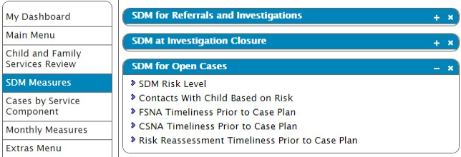
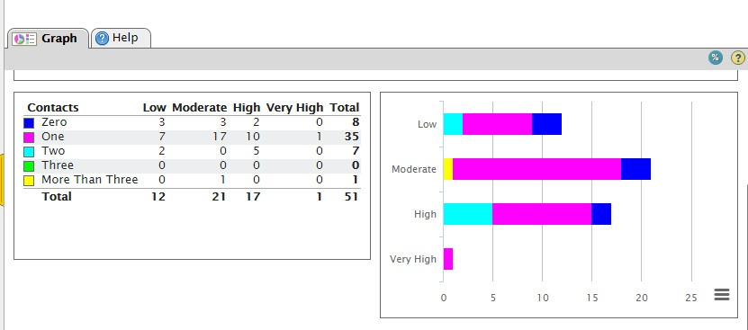
Which cases are the priority?
Notes:
Here is one report option in SafeMeasures. You select SDM Measures as the menu, then look under “SDM for Open Cases” and select “Contacts With Child Based on Risk.” (arrow)
When the report opens, select the timeframe “open on.” This slide shows percent view, but either is fine.
Note that this is not exactly measuring SDM guidelines. What is different? (SDM guidelines are for parent and child visits when they are seen together. This measures visits with child.) Computers can’t always count things the way a best-practice policy would recommend, and the key audit standard has always been child visits.
Answers:
What was the risk level of every case that had more than three contacts? Very high
What percentage of very high-risk families received zero contacts? 0%
How many contacts did most moderate-risk families receive? Two
If you supervised this unit, what changes would you like to see next month? Reduce the number of moderate-risk families getting more than one contact per month; get at least one contact per month to every high-risk family; increase the number of contacts per month for high-risk families.
Why does the SDM system recommend not keeping low-risk and moderate-risk cases open? Those families are less likely to maltreat their children, and low- and moderate-risk families do just as well in community services, while higher-risk families do best with multiple contacts.
Under what conditions would it be appropriate to provide a second or subsequent contact to a low- or moderate-risk family when there is a high- or very high-risk family who has not yet been seen? When there is a new referral and/or safety threat.
How often should you track this measure for your unit? Since SafeMeasures is refreshed twice a week, it’s not necessary to look every day. One strategy is to look once on the first of the month and create a list for every open family, sorted by risk. As the first visit is made, tick it off. Run the list again with two weeks left in the month. If you aren’t halfway through your list, you are getting into trouble. Run it with a week to go, and tick off cases as they are contacted. Is a case missing a contact and the worker is out sick or on vacation? Better assign a second person, or contact the family yourself.
So how do you use this for time management? When a worker asks for help prioritizing, you can use this to see which contacts are urgent. If a worker is debating between seeing a moderate-risk family a second time in the absence of a safety threat, while some higher-risk families have not yet been seen, the answer is pretty clear. Of course there can be clinical judgments made to do something different, but this is a place to start, and if you do something different, just be able to explain your clinical reason. (Note to trainer: Other SafeMeasures reports can be drawn to create overall prioritization, including which case plans are overdue, which assessments are overdue, etc.)
This slide ends the module section on contact guidelines.

Slide 101
Assigning Cases
Notes:
Note to trainer: The sections on assigning cases and keeping up with reassessments are for ongoing supervisors. If your class is entirely composed of hotline and/or ER supervisors, you can skip these short segments and spend more time on the approval sections.
Knowing that in an ideal world a worker will PLAN to spend more time on a higher-risk case, and that higher-risk cases probably already do consume more worker time on average, it makes sense to think about risk-based WORKLOAD, not just head-count CASELOAD, when deciding who should get the next case you have to assign. This section will provide an idea for an easy way to incorporate risk-based workload into your decisions, as well as how you can use SafeMeasures to monitor.
We should mention that while we are letting you know a few tips for using SafeMeasures to make your life easier, this isn’t designed to be a SafeMeasures training. That really needs to be in a lab. But you should know that the training academies now have trainers who will be teaching both basic navigation of SafeMeasures and a special advanced SafeMeasures day just for supervisors, to help you create a personalized usage plan. I’d encourage taking that class as soon as you can … you’ll be surprised how much help SafeMeasures can be. Okay, end of commercial.

Slide 102
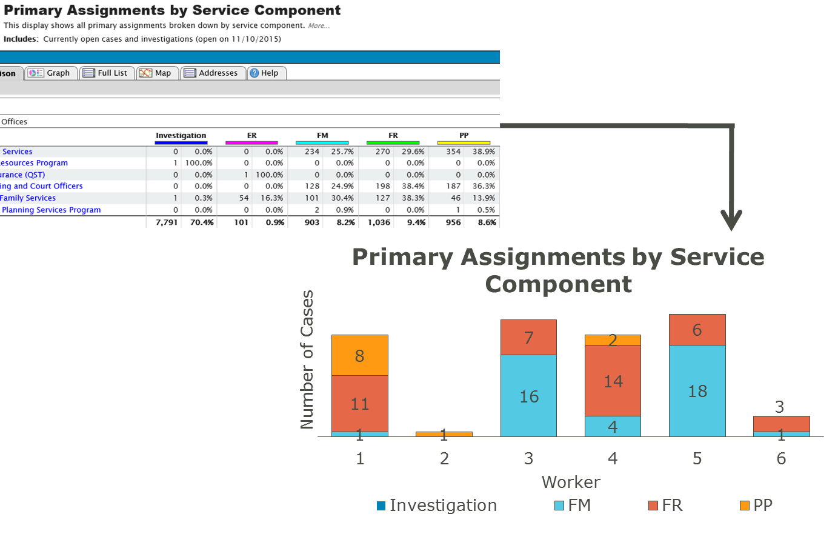
Who would get the next case?
Notes:
Note to trainer: The sections on assigning cases and keeping up with reassessments are for ongoing supervisors. If your class is entirely composed of hotline and/or ER supervisors, you can skip these short segments and spend more time on the approval sections.

Slide 103
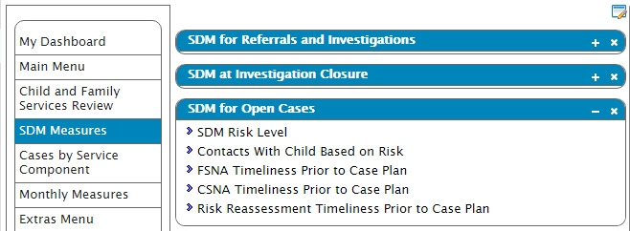
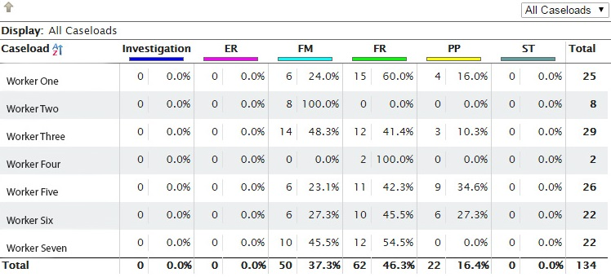
Adjusting for Risk Level
Low Risk (x1)
Moderate Risk (x2)
High Risk (x3)
Very High Risk (x4)
Notes:
You can. 1) Select the SDM Measures menu; 2) Select SDM for Open Cases and pick “SDM RISK LEVEL”; 3) Select the “comparison” tab and then filter and drill down for your unit.
You will get a table that shows the known risk levels for open cases. Look at the TOTAL column. How does this compare with the totals from the other report? (They are slightly different.) Does that mean one must be wrong? (NO.) What could explain different numbers? (The risk level only includes FM and FR cases, while the caseload report shows ER and PP also. Additionally, because cases open and close constantly, if the extract date or even time of extract was slightly different, a case or two could have opened or closed between generating reports.)
We know that the PP cases won’t show up with risk levels, so we will add those into our mix. For the FM and FR cases, this unit has current risk values for every open case. (Yes, this is a real unit—there are some like that!) If a worker has not assessed risk, you may consider giving that case a value of 1. That creates an incentive for workers to make sure they have risk levels, because only low-risk cases have a value of 1, so their workload is probably being underestimated!
For all other cases, multiply low risk by 1, moderate risk by 2, high risk by 3, and very high risk by 4. While this isn’t as precise as if we had measured workload values, at least it reflects that higher-risk cases take more time than lower-risk cases.

Slide 104
Now, who gets the next case?
72
47
48
66
54
12
4
Notes:
When we looked at just total number of cases assigned, Workers 1, 3, and 5 looked more equal. When we are adjusting for risk, we are looking only at FM and FR cases assigned, and the number of cases looks much different.
Applying the math to adjust for risk level, the relative workload for each worker is as follows:
Note to trainer: Click to make workload values appear on the chart.
Worker 1: 72
Worker 2: 12
Worker 3: 54
Worker 4: 4
Worker 5: 47
Worker 6: 48
Worker 7: 66
When looking only at the number of total cases assigned for all program types, Workers 6 and 7 had the same number of cases (22). However, Worker 7 has a larger workload, based on the number of very high-risk cases.
If you were to assign solely based on number of cases assigned (excluding Workers 2 and 4), then you might decide the next case should go to either Worker 6 or 7 because they have fewer cases than Workers 1, 3, or 5. But when you adjust for risk, it makes more sense for the next case to be assigned to Worker 5 or 6.

Slide 105
Additional Data
Are open cases really “open,” or just “not closed”?
How many open cases are missing a risk level?
Worker variables:
Experience
Expertise/specialization
Stress management / time management
System variables:
Location
Planned time off
Beware of punishing good workers!
Notes:
In this example, knowing the risk level made the workload look different than if we knew just the caseload.
There are other important considerations as well. For example, if you have one worker with a perpetually high caseload, drill down into his/her cases to see how long they have been open, or even whether they are actually closed, but just not “closed” in CWS/CMS.
If workers allow many cases on their caseload without a risk level, you will have a harder time knowing their true workload.
There are also worker variables. Newer workers often can’t handle large caseloads well. Some workers have expertise or specializations, such as languages or medically fragile infants. Some workers get really stressed at times, often for good reasons, so we try to give them a little break. There’s a danger in relying heavily on really good workers who don’t complain a lot, and inadvertently burning them out.
There are system variables. Larger counties assign by location. Workers about to take a leave aren’t good choices for cases needing quick attention.
You have a lot to consider, and SDM risk level is just one piece of the mix. But it is a piece that should not be overlooked. Workers willing to take on higher-risk cases should be rewarded by having fewer of them, so that they will have a chance to effect real change.
Note to trainer: This slide ends the section on assigning cases.

Slide 106
Keeping Up With Reassessments: The Joneses Were Easy!
Notes:
One final supervisory chore we’ll tackle today is trying to help your workers keep up with when reassessments are due.

Slide 107

How do you know when case plans and court reports are due?
Lists
Calendars
File cards
Notes:
What do you do to keep track of when case plans, court reports, or SDM assessments are due?
For generations, supervisors have kept lists, calendars, or file cards, ranging from simple to elaborate. Some are color-coded. Some are cross-referenced. How much time do you spend? Add it up over a year. Multiply that times the number of supervisors.
Has anyone used SafeMeasures to do this job for you? Let’s look at how this can work.

Slide 108

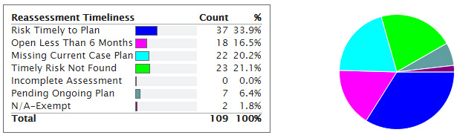
Two Birds With One Stone
Notes:
Here is one report that can tell you if current cases are up to date on case plans AND risk reassessments or reunification reassessments.
First, select the SDM Measures menu. Then, at SDM for Open Cases, pick “Risk Reassessment Timeliness Prior to Case Plan.” Third, select your desired timeframe.
This is an actual graph, filtered to an anonymous unit somewhere in California. The pink slice has been open for less than six months, so it is not yet due. You don’t have to worry about these just yet. You could drill down and sort them by case open date to see which ones are coming due and when. The dark blue are current with both case plan and risk level. (NOTE: This report draws risk level from the risk reassessment for FM cases and from the reunification risk level for FR cases.) You don’t have to worry about these either. The gray ones have a case plan pending. It would be good to keep an eye on those and be sure they don’t get lost in the “pending” limbo. The light blue ones are missing a current case plan. The green ones have a current plan, but did not have a risk assessment done prior to the plan.
Of course you can drill into this and ask each worker with past-due plans or assessments to get up to date.

Slide 109
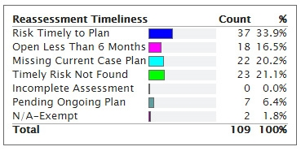
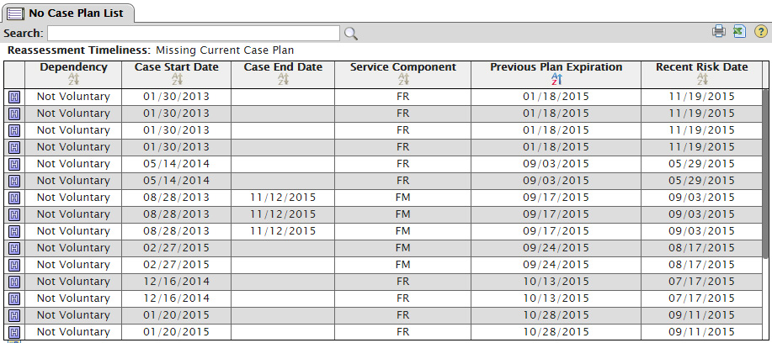
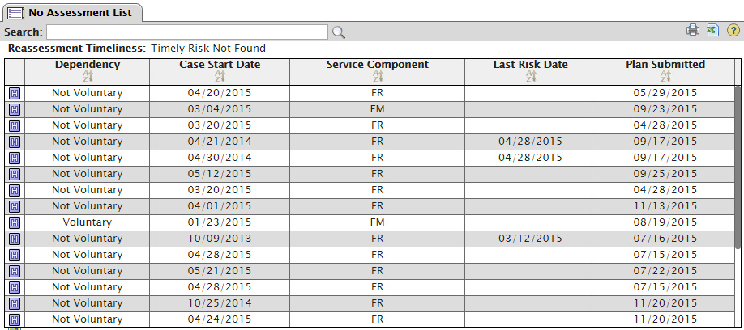
Drilling Down
Missing case plan. List sorted by most overdue.
Current case plan, but missing risk reassessment.
Notes:
Here is what it looks like when you drill down. All of the identifying information (case name, case ID) has been hidden. As mentioned, you can sort the lists to easily see how old something is and/or when the next thing is due.
Letting SafeMeasures take over some of your list-keeping may save you a little time. Try it for a month and be sure that everything you need can be captured in SafeMeasures before you throw away your old list.

Slide 110
What would you do with a list that shows…
Worker 1 is up to date on all case plans, risk assessments, and FSNAs.
Worker 2 has two case plans overdue by less than 30 days. All else is up to date.
Worker 3 has all case plans up to date but is missing 80% of risk reassessments and 100% of FSNAs.
Worker 4 has only about half of case plans done, but has risk and FSNA on all cases that do have a case plan.
Notes:
Let’s think about what you would do with this information. One idea is just to keep giving workers lists of what is overdue or about to become overdue. Another idea is to analyze patterns to see if you can solve the root causes.
For example, suppose your report shows this. What would that suggest? What would you do?
Possible answers:
Look at potential workload inequities across these workers and adjust if necessary.
Determine whether there is a knowledge, skills, or attitude gap regarding completion requirements on reassessments.
Assess the fourth worker’s case plans to see if case planning could be more efficient based on results of FSNA completion.
Discuss the use of the FSNA with the third worker to better understand why case plans are being written without first completing the FSNA.
Assuming that the first worker’s caseload is appropriate (i.e., that worker has roughly the same work burden as the others), talk to the first worker about the strategies he/she uses to stay up-to-date, to see if any can be used by other workers.
Read one randomly selected case (with completed assessments and case plan) from each worker to get a rough sense of the quality of completion. Is Worker 4 a perfectionist? Is Worker 1 rushing, to the detriment of accuracy?

Slide 111
What would you do with a list that shows…
All workers are missing about 30% of case plans, and of those cases that do have case plans, about 30% are missing risk reassessments and FSNAs.
Notes:
What would you do in this situation?
Possible answers:
Determine what, if anything, is common about the 30% of cases without case plans, and see if there is a specific workload barrier occurring.
Talk with workers about what they see as barriers to both case plan completion and risk reassessment/FSNA completion.
Randomly review a sample of case plans with and without completed FSNAs to see if there are trends.

Slide 112
What would you do with a list that shows…
All workers are up to date on all case plans and SDM assessments.
Notes:
And this?
As a reminder, we often spend a lot of time talking about how to fix what’s broken, but not much time talking about how to sustain what is working. Be sure to let your staff know when you notice good data! Tell others. Make them proud!
Note to trainer: This slide ends the section on keeping up with reassessments and is also the end of Module 2. Switch to the Knowledge Review Game Show PowerPoint. Introduce the game show by explaining it is a little like “Who Wants to Be a Millionaire?” Divide the class into two teams. Each team selects a “final answer” person. You will ask questions to each team, one at a time. There will be four possible answers, only one of which is correct. Teams have up to one minute to arrive at a final answer. The team is one lifeline, and the P&P Manual is the other. They have unlimited use of their lifelines.
Create a name for each team, and on a flip chart, write one team on one side of a vertical line and the other team on the other. For each correct answer, one point is scored. No point is scored on an incorrect answer, and the other team has one minute to “steal” the point by answering correctly. They then get their regular turn.
There are far too many slides to get through all of them. There is a menu, and if you have a mixed group, you can take a few from each section. If you have mostly ER supervisors, you may work through all of the ER questions and fill in with others as time allows.

Slide 113
Thank you!
Notes:
Note to trainer: Conclude by going around the room and asking each person to state what they see as the most significant “take-away” from the session.
Thank everyone for their participation.

Slide 114
Allegations on Mom:
Mom and Dad live together
Notes:
Complete SDM assessments on this household.
Note: The hyperlink takes you back to Slide 17, basic definitions. Either click the hyperlink to return there or proceed to the next slide for more discussion on which household to assess.

Slide 115
Allegations on Mom: Mom and Dad live apart, Child lives with Mom
Mom’s household
Dad’s household
Notes:
Complete SDM assessments on mom’s household.
Note: The hyperlink takes you back to Slide 17, basic definitions. Either click the hyperlink to return there or proceed to the next slide for more discussion on which household to assess.

Slide 116
Allegations on Dad: Mom and Dad live apart; Child lives with Mom
Mom’s household
Dad’s household
Notes:
Complete SDM assessments on dad’s household.
Note: The hyperlink takes you back to Slide 17, basic definitions. Either click the hyperlink to return there or proceed to the next slide for more discussion on which household to assess.

Slide 117
Allegations on Mom and Dad: Mom and Dad live apart; Child lives with Mom
Mom’s household
Dad’s household
Notes:
Complete SDM assessments on mom’s household AND on dad’s household.
Note: The hyperlink takes you back to Slide 17, basic definitions. Either click the hyperlink to return there or proceed to the next slide for more discussion on which household to assess.

Slide 118
Allegations on Mom:
Mom lives with her sister AND her sister’s family—no allegations on sister
Notes:
Complete SDM assessments on mom’s household. All individuals are part of the household. Sister MAY be a secondary caregiver for mom’s children.
Note: The hyperlink takes you back to Slide 17, basic definitions. Either click the hyperlink to return there or proceed to the next slide for more discussion on defining which household to assess.

Slide 119
Allegations on Mom: Mom lives with her sister AND her sister’s family AND there are allegations on sister
Notes:
Complete SDM assessments on mom’s household. All individuals are part of the household. Sister MAY be a secondary caregiver for mom’s children. ALSO complete SDM assessments on sister’s household. All individuals are also part of sister’s household. Mom MAY be a secondary caregiver for sister’s children.
Note: This slide ends the “digging deeper” portion of the discussion on defining a household. The hyperlink takes you back to Slide 17, basic definitions.

Slide 120
The SDM® System
Intake
  Screening and Response Priority—Does this require a response? How quickly?
Investigation
  Safety—Can the child remain in the home, with or without a safety plan?
  Risk—What is the likelihood of future harm to the child? Should the file be opened for continuing services—FM or FR?
Ongoing
  Family strengths and needs assessment—What are the priority needs for the case plan?
  Risk reassessment—For in-home files. Has the case plan helped reduce risk of subsequent harm? Can we close the case?
  Reunification reassessment—For out-of-home files. Can the child safely return to parental care?
Notes:
Screening Criteria Assessment: Determine if a report meets agency criteria for investigation.
Response Priority Assessment: Helps determine how soon to initiate an investigation.
Safety Assessment: Determine if an there is an immediate threat of harm to a child.
Risk Assessment: Evaluates the risk of future abuse or neglect.
Child Strengths and Needs Assessment: Identifies each child’s major needs and helps establish a service plan.
Note: The hyperlink goes back to Slide 61, Basic Principles.
Family Strengths and Needs Assessment: Helps determine a family’s optimal level of service and guides the case planning process.
Risk Reassessment: Ensures that ongoing treatment is appropriate.
Family Reunification Reassessment: Determines whether or not a child should be returned to his/her home.

Slide 121
Narrative
Common Approach
Suggested Approach
Chronological narrative
He said/she said
Unresolved contradictions
Missing links
Summary sections
  Screener narrative
  Investigation summary
  Court reports
  Template contact note
Explain item scores
Omit unnecessary information

Slide 122
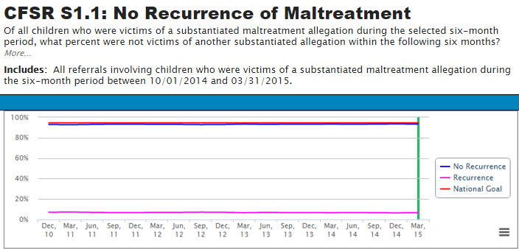
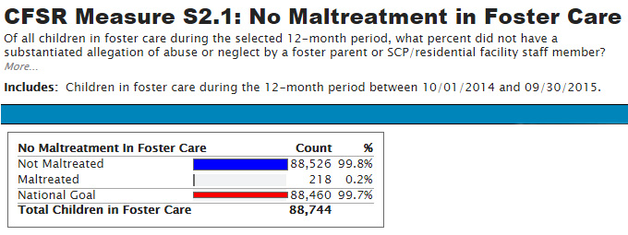
Safety: Statewide Data
Notes:
Click hyperlink to return.

Slide 123
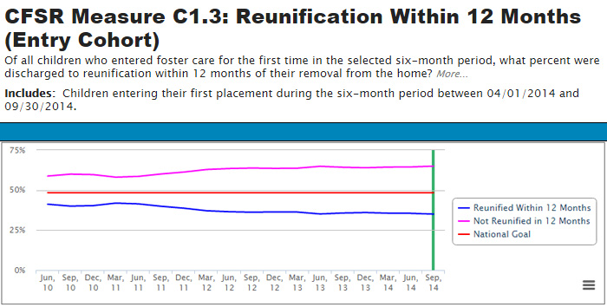
Permanency: Statewide Data
Notes:
Click hyperlink to return.

Slide 124
How do you know?
Fact
Wonder
Suspicion
Assumption
Return to Slide 67
Return to Slide 89
SOURCE: Mark Miller, California Risk Assessment Training
Notes:
Click hyperlink to return.

